Slide 1



Low-cost, open-source lithium-ion cell health assessment
Enabling second-life battery production
Notes:
Good morning, everyone and welcome to this presentation about ‘LiFETIME’, a project run by the 2022 Mres Sensor CDT cohort, to tackle a Team Challenge on ‘Open-source battery health monitoring’.

Slide 2
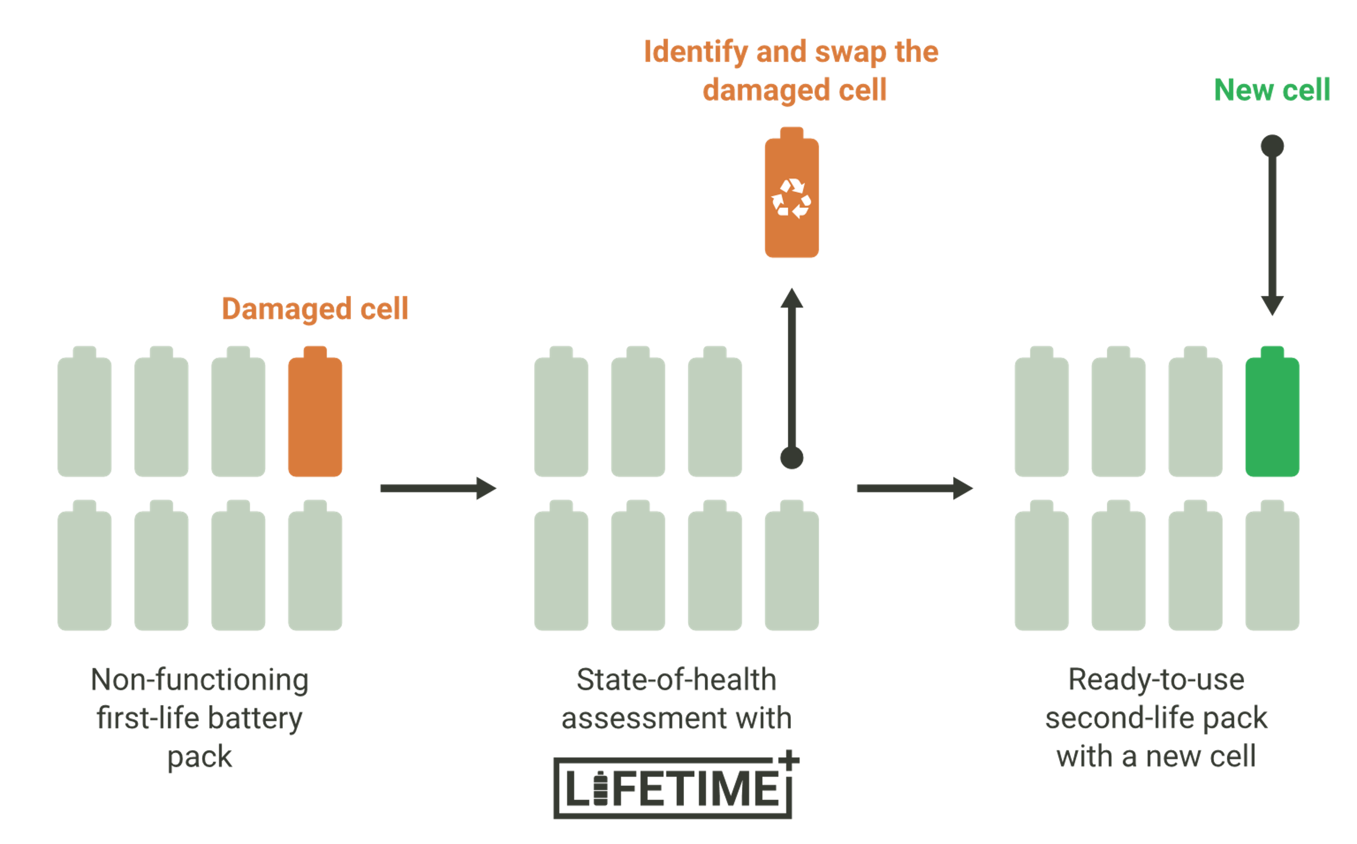
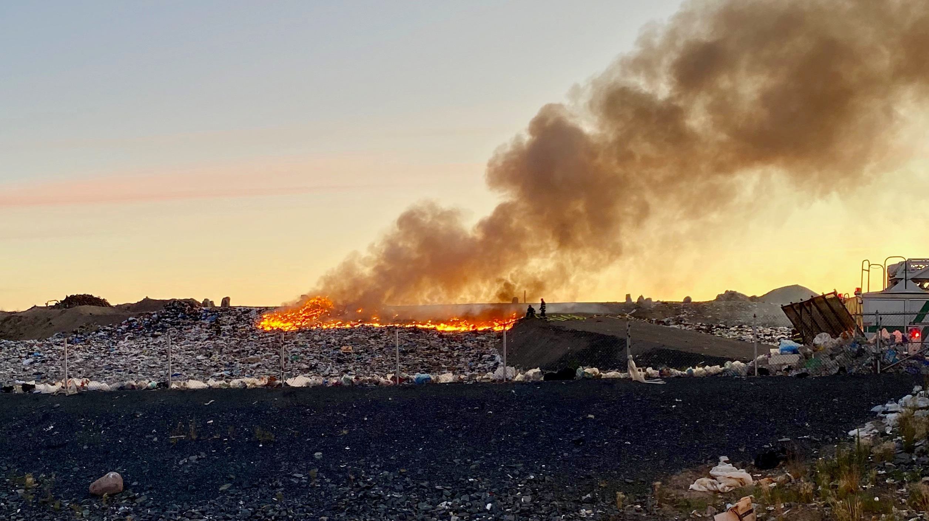
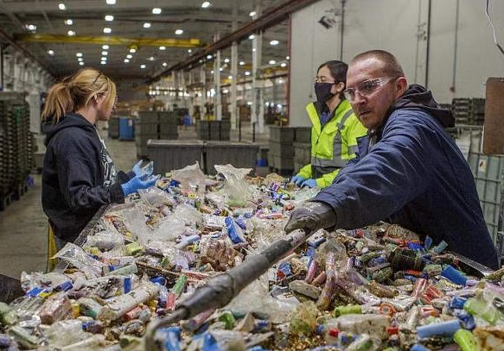

End-of-life Electric Vehicle Batteries
Landfills
95%
Problem
Used lithium-ion batteries from
electric vehicles (EVs) sent to landfill
Materials recycling
Need
Solution
<5%
Efficient technology
for measuring cell health
Reuse of EV battery cells for reuse in
second-life applications
Reuse
HOW?
negligible
Notes:
Large battery packs, typically from electric vehicles (Evs) are formed by individual cells.
When a battery fails, a single damaged cell can degrade the whole battery’s performance, even if the other cells are still functional.
This compromises the safety, efficiency and reliability of the battery pack.
At this stage, end-of-life battery packs are taken to one of three destinations: landfill, recycling or reuse.
Today, only 5% of the world’s lithium-ion batteries are recycled and a negligible amount is re-purposed or re-used.
This leaves almost 95% of used lithium-ion batteries being sent to landfill, leading to enormous environmental, financial, safety and energy-security challenges.
So why aren’t we recycling and reusing more cells?
On one hand recycling is challenging due to the energy demanding chemical processes, expensive logistics and specialized equipment
On the other hand, there is a lack of technology, regulation and performance standardization for reuse.
To solve the problem of used lithium-ion batteries sent to landfill, we need an efficient solution, which could enable cell reuse in second-life applications
But the question is: HOW?

Slide 3
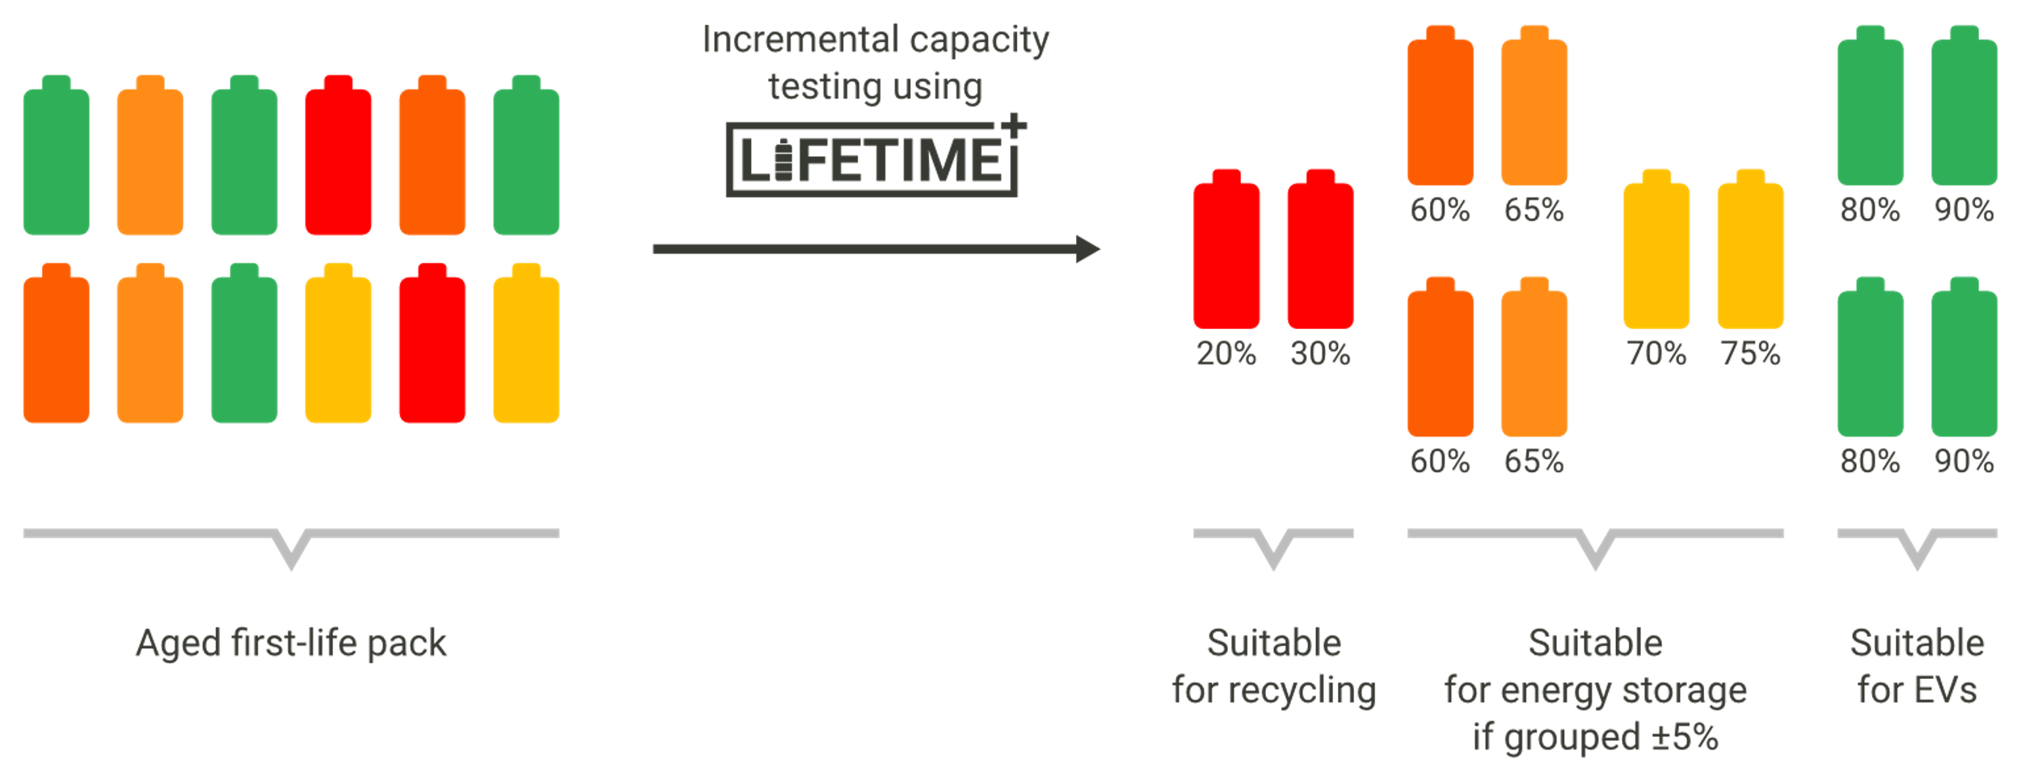





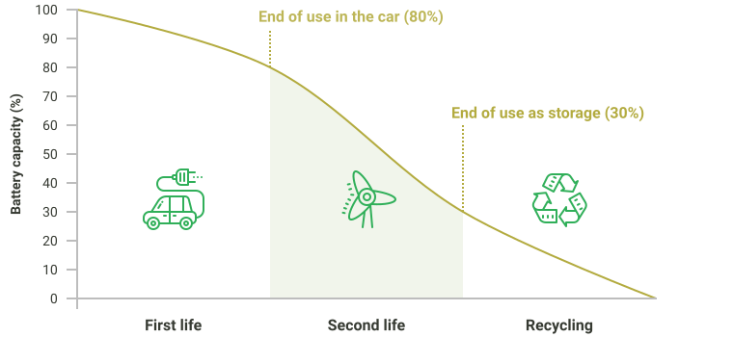
Cell health assessment enables reuse
determine cell health
Notes:
To re-use batteries, still-viable cells need to be grouped and assembled into second-life battery packs
To optimize the second-life battery’s performance it is important to assess the SoH as close to the cell level as possible and minimize cell-to-cell inconsistencies
Grouping cells in capacity bands, ensures that their charge and discharge cycles are balanced and makes second-life battery packs more suitable for specific applications, reducing the likelihood of overcharging and accelerated degradation
We have decided to group cells together within 5% of their capacity. As a rule of thumb, cells >80% are still fit for EVs, cells between 80% and 30% are typically used for energy storage and below 30% they must be recycled. However, there are no internationally accepted standards for categorization, providing an additional layer to the challenge.
In order to achieve this goal, we need cell health assessment, so our group decided to develop a low-cost, open-source testing kit that measures the state of health of lithium-ion cells, to enable reuse.​

Slide 4
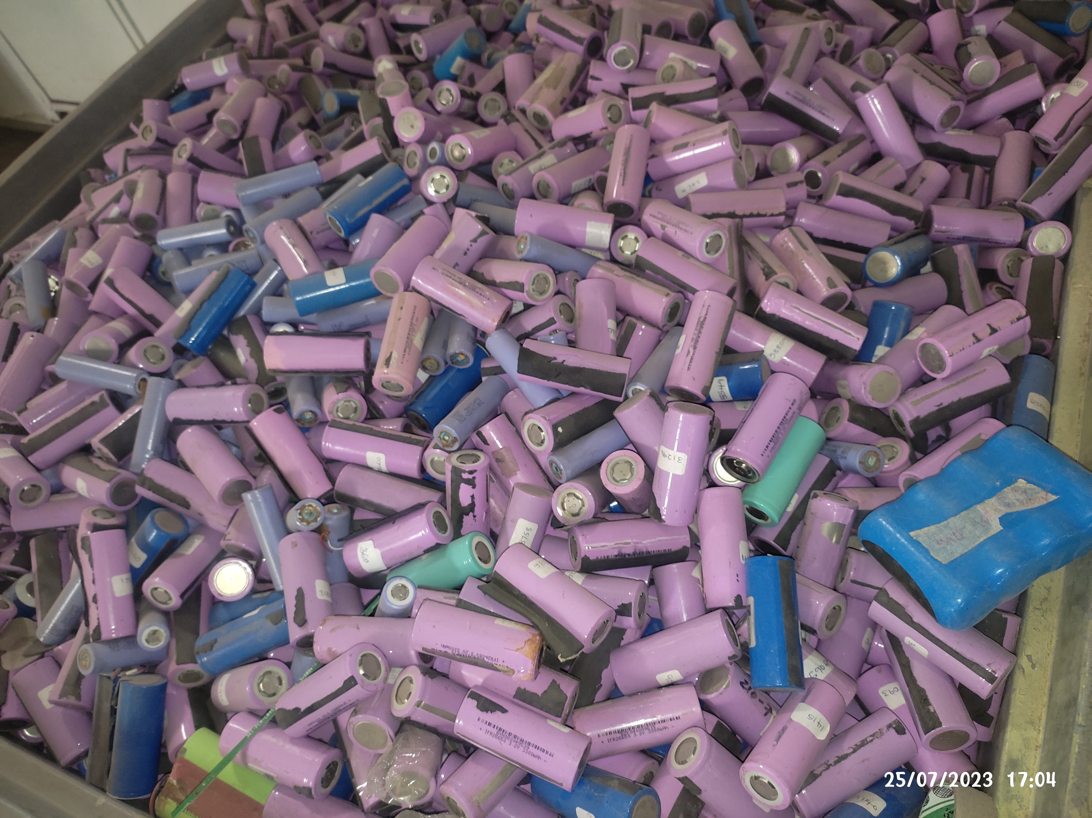
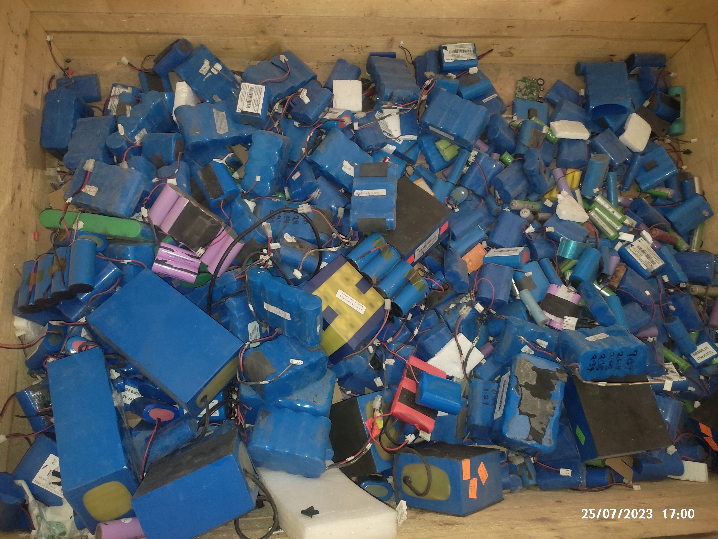
Circular Economy of EV batteries
In markets with a demand for less power-heavy applications, battery reuse can provide the most value, compared to traditional recycling and disposal
Image credit Joy Nyangweso, WEEE Centre,
Nairobi, Kenya
Image credit Joy Nyangweso, WEEE Centre,
Nairobi, Kenya
Notes:
For our project, we have partnered up with businesses in Low- and Middle-Income countries, where there is a lot of e-waste accumulation and a growing demand for less power-heavy applications, like stationary energy storage.
In this context, small EV businesses, recycling centres, e-waste management companies and researchers are dealing with used cells that have reached their end-of-life ​​
It is in these markets, battery cell reuse can provide the most value, compared to traditional recycling and disposal.

Slide 5


Aim: Testing equipment for cell health assessment in Low- and Middle-Income Countries
Challenges
Requirements
Component availability
Cost-effective and accessible materials
Diversity of battery types
Open-source
Battery safety
Safe
Government guidelines
User-friendly
Time efficiency
Portable
Accuracy
Notes:
With LMIC end-users in mind, we decided to build a solution to provide testing equipment for measuring cell health from used battery packs in Low and Middle Income Countries.
Designing appropriate technology means taking the contextual challenges into consideration
To understand these challenges, we conducted thorough market research and our attention was drawn to the restricted component availability and supply restrictions.
Two other major challenges are linked to battery pack disassembly and testing safety, as well as to the lack of regulation and policy.
Finally, two technical challenges were the limited time-window of the project and the accuracy-cost-efficiency tradeoff.
Hence, we decided that our device needs to be cost-effective, open-source (so that it can be adaptable), safe to use and user-friendly and portable in the sense that users can perform tests in various locations, without the need for access to specialized laboratory conditions
Due to the underlying safety concerns of disassembling and cycling battery cells, we decided that the target users must be engineers or scientists with expertise in technical work with batteries.

Slide 6



Our approach
Industry needs
End-users
Impact
MARKET RESEARCH
Capacity measurements
Charge and discharge
Cell cycling toolkit
HARDWARE
Data-driven modelling approach
Incremental Capacity Analysis
Dataset, software package & app
SOFTWARE
Education campaign
Open-source community
Co-creation workshops
OUTREACH
Notes:
First, we conducted market research to understand the industry needs, the user-requirements and the true scale of the problem,
Next we split the project into three streams:
Hardware: tasked with building a cell cycling toolkit for cylindrical 18650 cells. This can perform capacity analysis through charge and discharge
Software team: adopted a data-driven modelling approach. We chose Incremental Capacity Analysis which is a DC method used in industry. The outputs were building a dataset, creating a software package and an app user-interface.
Outreach: was in charge of spreading awareness through an education campaign, creating open-source documents and engaging with the open-source community and planning co-creation workshops

Slide 7









Eleni Papafilippou
Project Manager
Melissa Watt
Project Deputy
Nicolas Spiesshofer
Project Office
MARKET RESEARCH
HARDWARE
Robert Petrie
Hardware
Jieni Wang
Hardware / Outreach
Jasper Ward-Berry
Hardware
SOFTWARE
OUTREACH
Tomas Paulik
Software
Aparna Kaaraal Mohan
Outreach
Alec Sargood
Modelling
Notes:
I will pass on to the rest of the team to dive into the details of our project, first handing over to Aparna to talk about market research.

Slide 8

MARKET RESEARCH

Slide 9



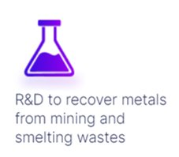
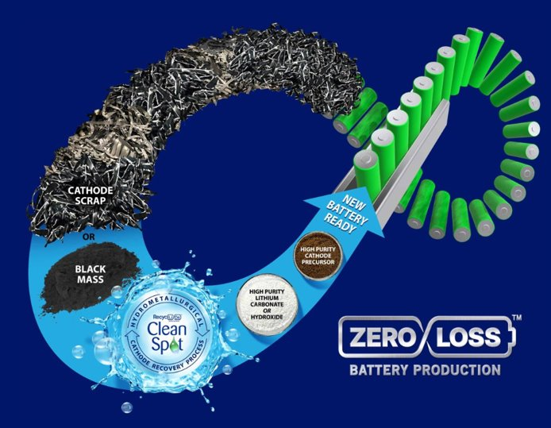
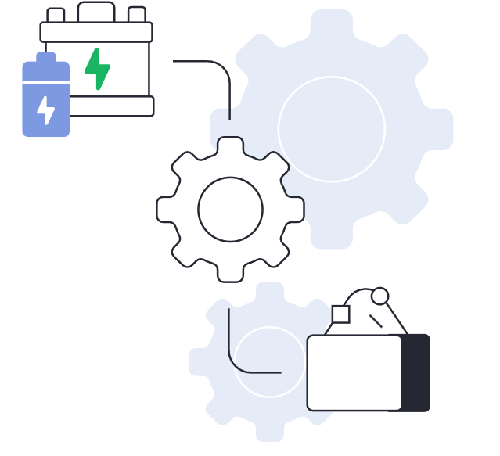
The most common process that used batteries are subjected to is recycling.

Slide 10
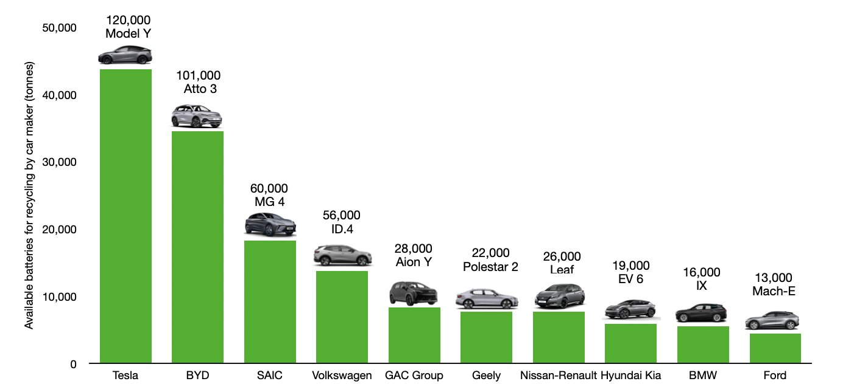

How many EVs can be powered with recycled battery materials alone, by 2030?

Slide 11

Recycling is a wasteful process
“The current method of simply shredding everything and trying to purify a complex mixture results in expensive processes with low value products”
Andrew Abbott, University of Leicester
It costs more to recycle Lithium than to mine more Lithium.
Only 5% Li batteries are recycled globally. The rest are dumped.

Slide 12

The star solution – Reuse

Slide 13
HARDWARE
Notes:
Technical vs/and social considerations
Safety focused design

Slide 14
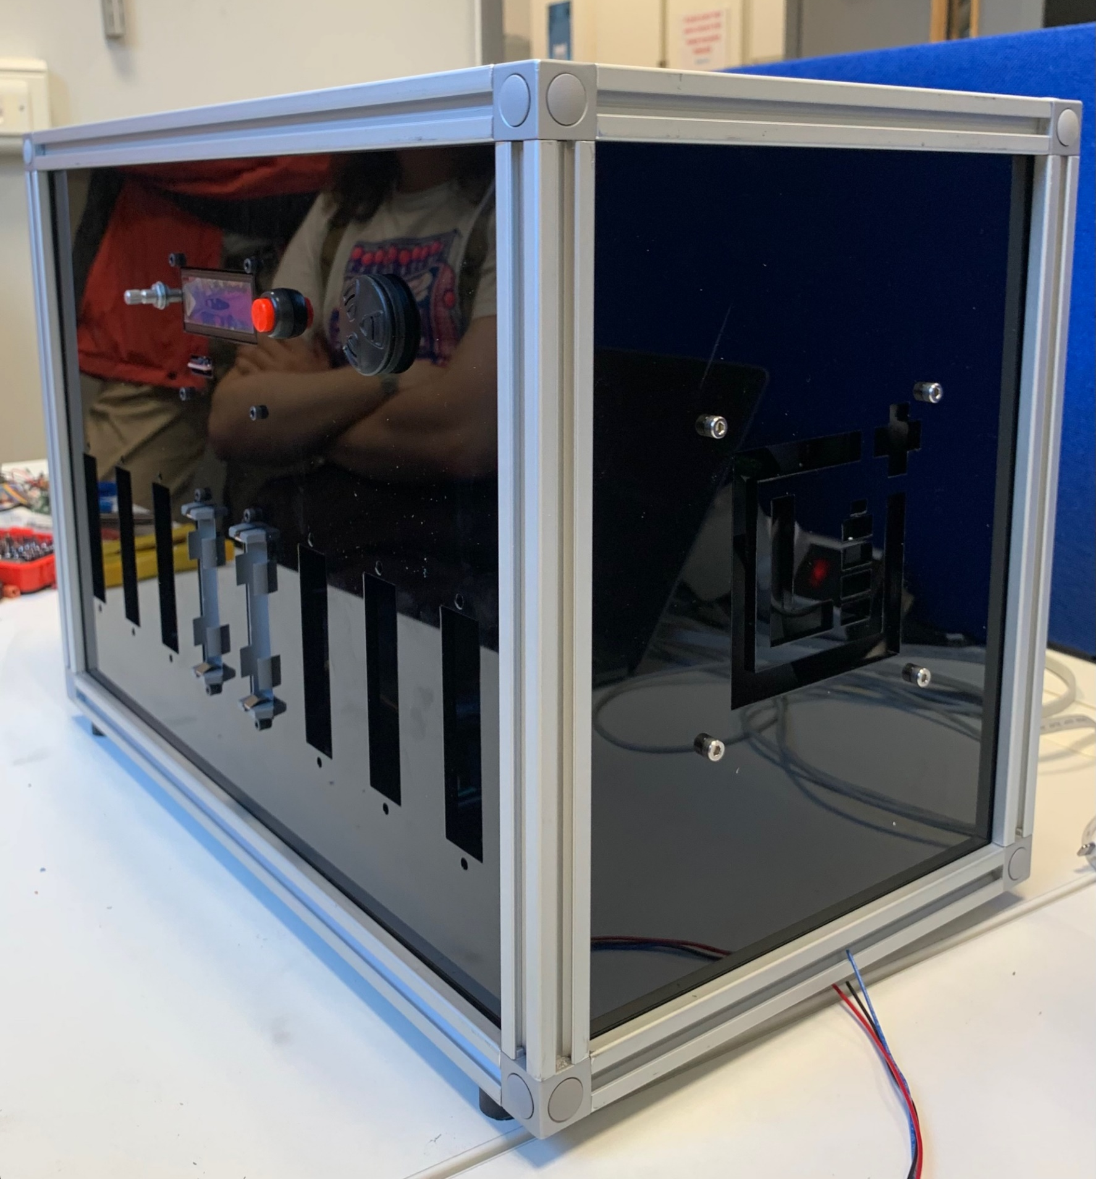
Specification
Pico W microcontroller – on board Bluetooth
Up to 8 channels (dis)charge with programmable current
Current and voltage measurement on all cells.
User interface with physical controls and LCD screen.
Power supply has capacity for all channels at maximum charge current
Notes:
Specs
Pi Pico - technically suitable, appropriately powerful and on board Bluetooth. Social - affordable, available in LMIC - Kenya factory
8 channels - mainly a technical consideration, means device isn’t too large, but still nice number of cells, nice for code
LCD - affordable, but still provides rich interaction (along with rotary encoder etc)

Slide 15
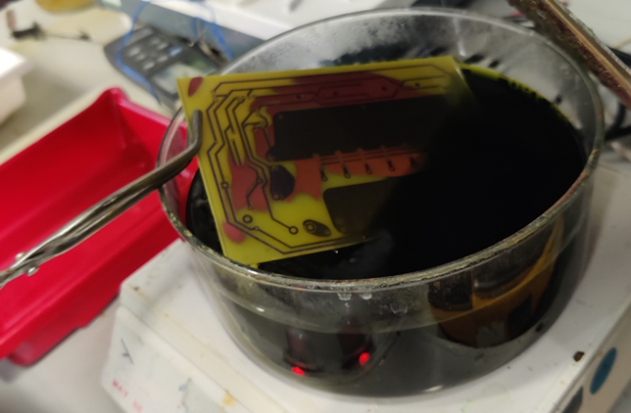
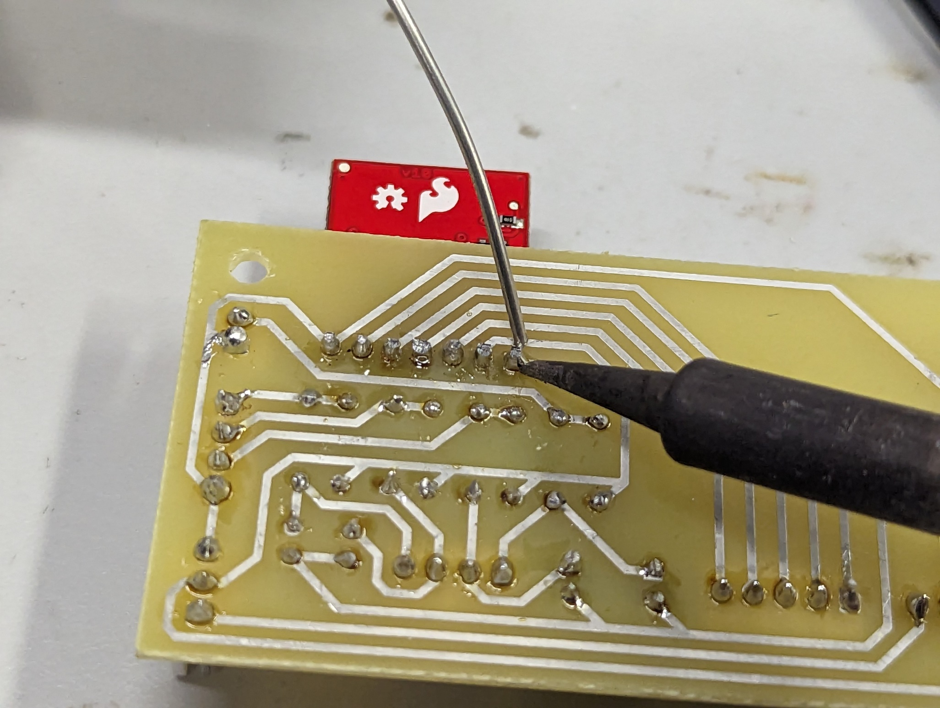
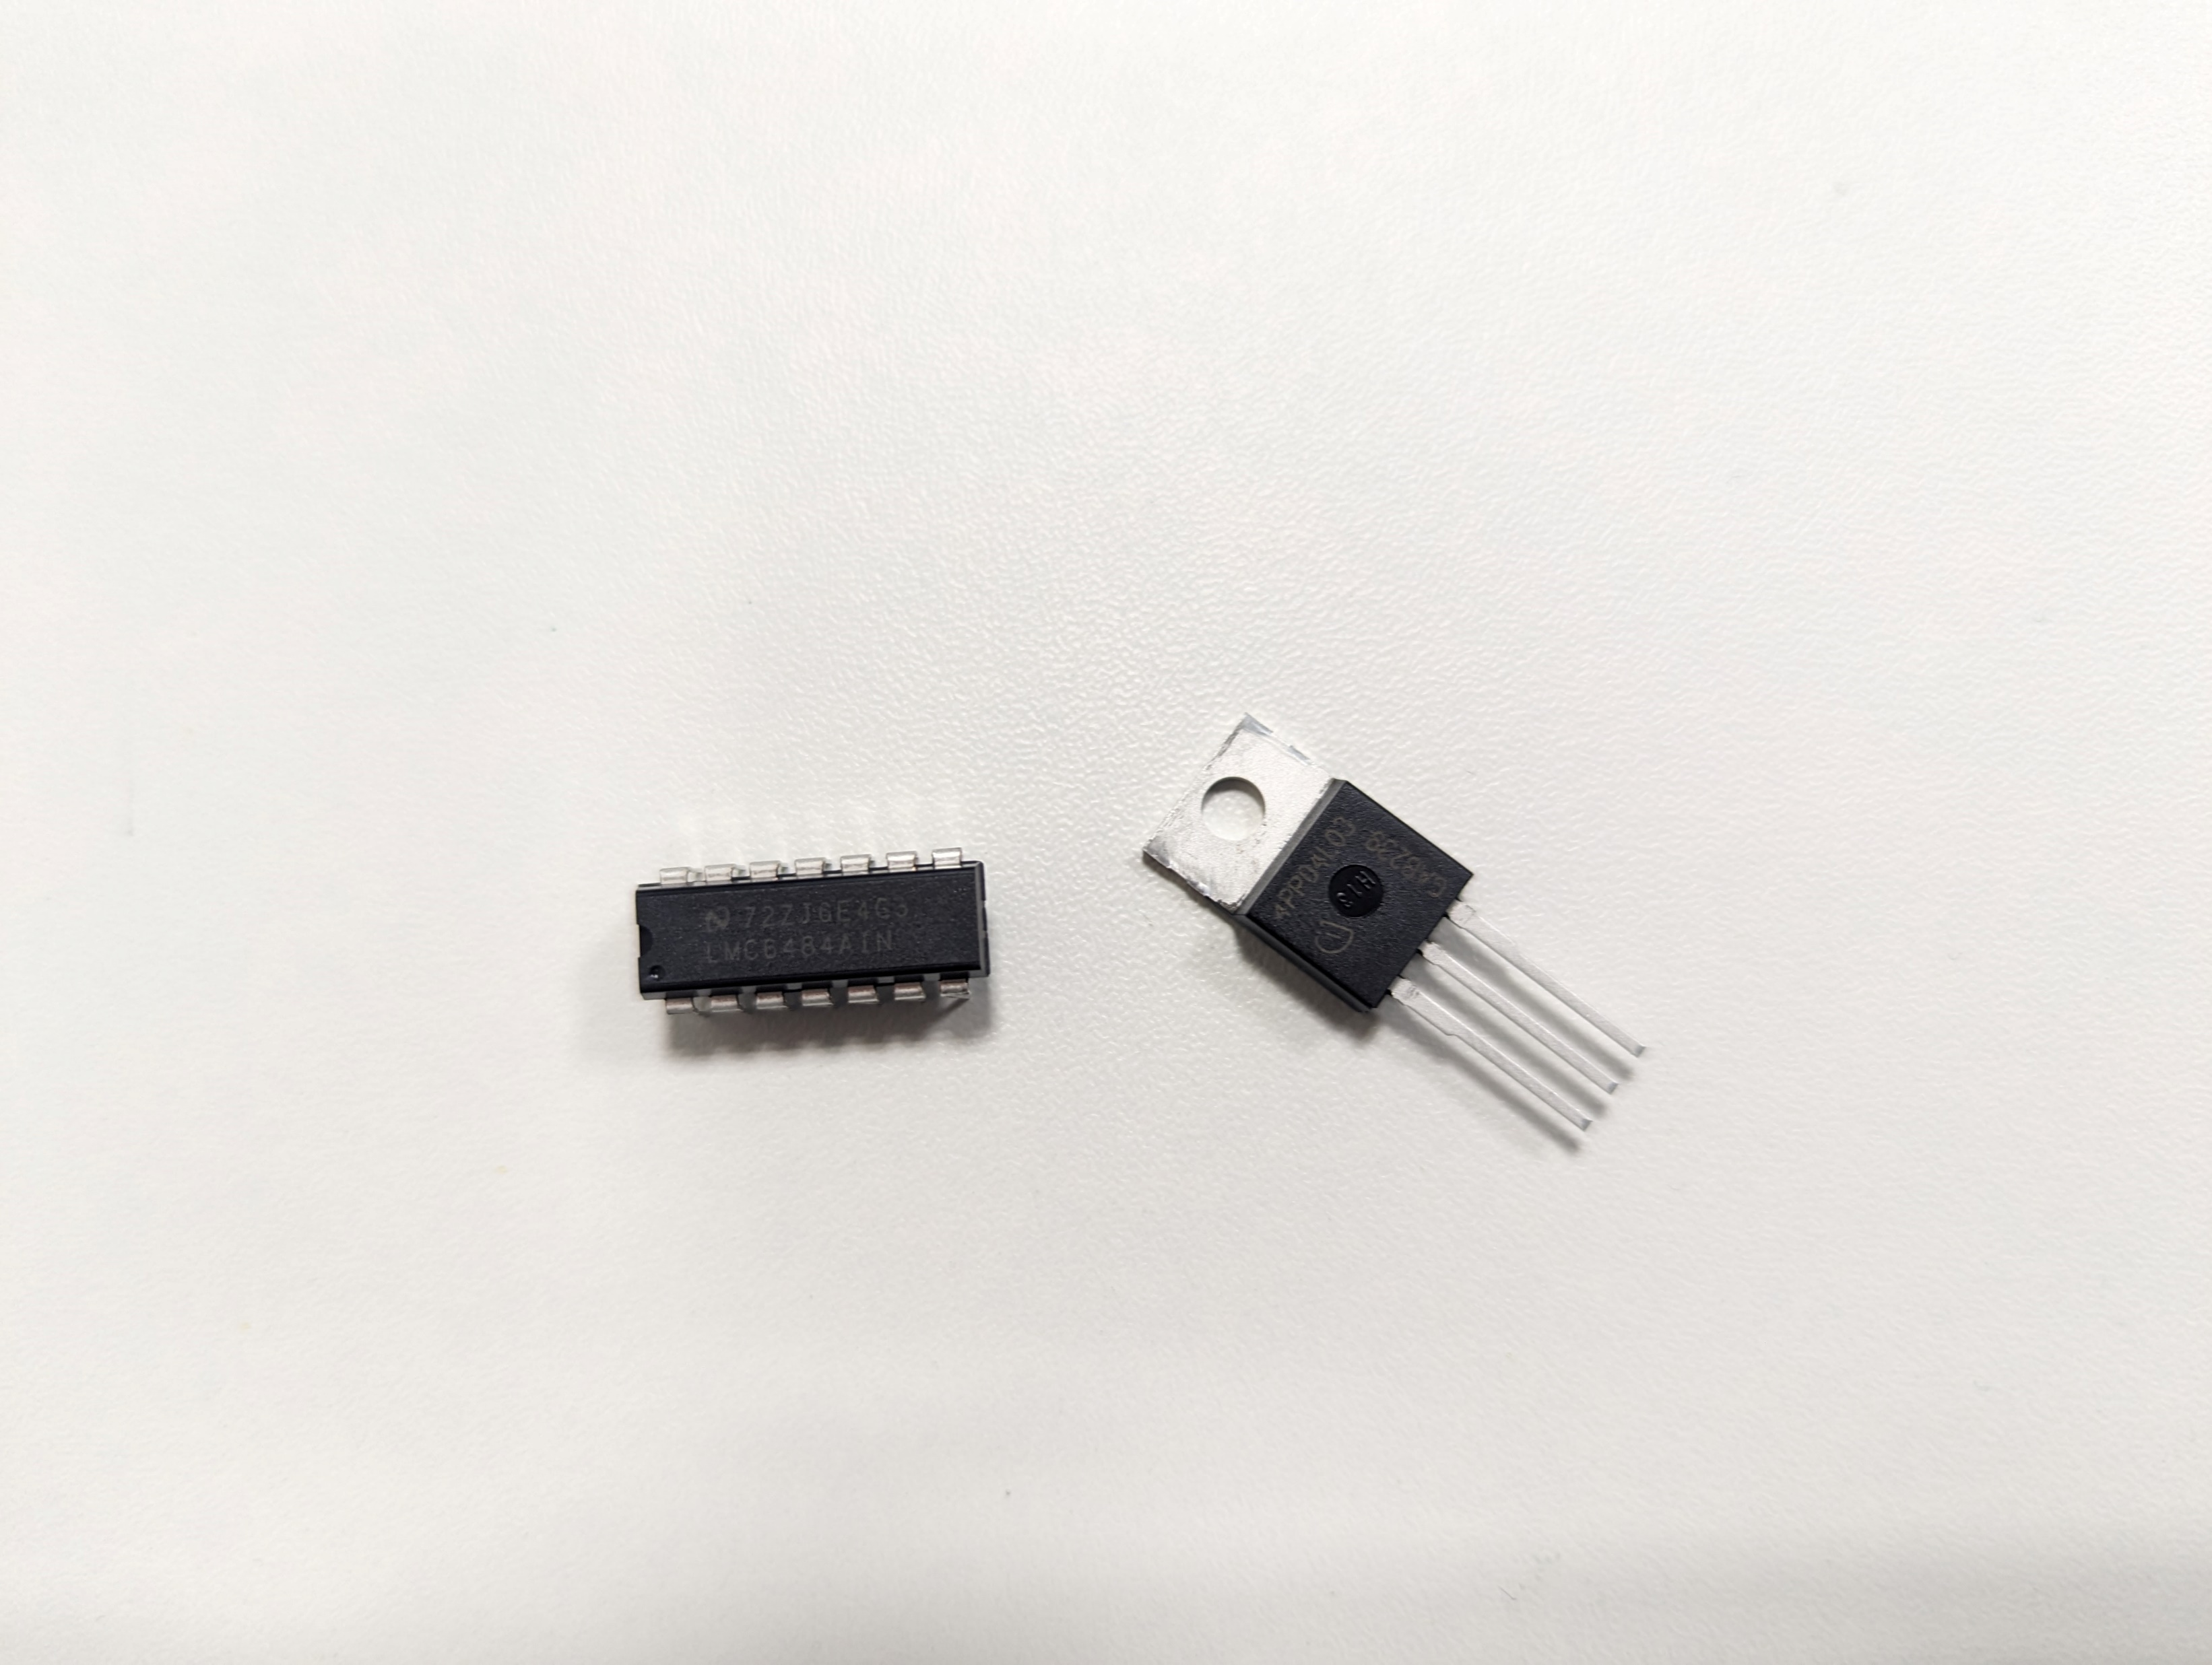
Part & Process Selection
Parts should be like-for-like interchangeable.
Through hole rather than surface mount.
Single sided PCBs, more complicated to route but easier to fabricate.
Relatively large PCB traces increase tolerance when fabricating.
Notes:
Using generic and discrete components means both easy to switch out if not available, and circuit is easier to understand – no ‘magic chips’
Through hole easy to fab board (larger size etch better) and easier to solder (no tiny pins)
Single sided board- balancing technical with social, multi-layer boards would’ve made our job easier, but less accessible manufacture. Chose single side boards bc they can be fabbed with readily available chemicals and equipment at a low cost.

Slide 16
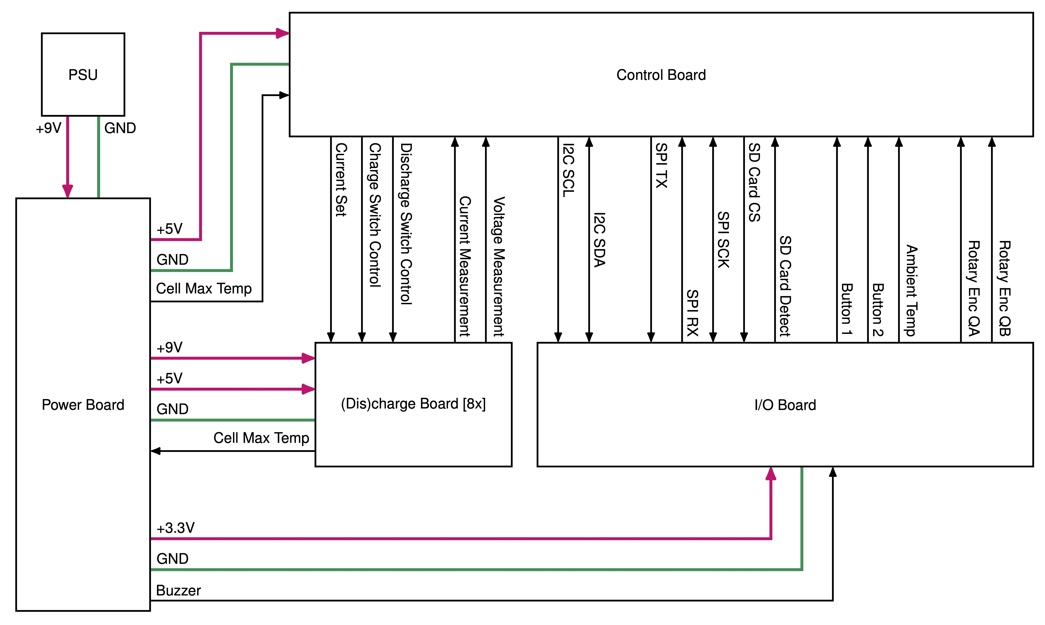
Electronics Overview
Notes:
Four boards
Power – supplies power to all boards
Control board – Pico is here, sends control signals, receives measurements from (dis)charge boards
I/O board – handles the things the user interacts with (screen, rotary encoder, SD card etc.)
(Dis)charge board – handles the actual charging and discharging of the cells (8x)

Slide 17
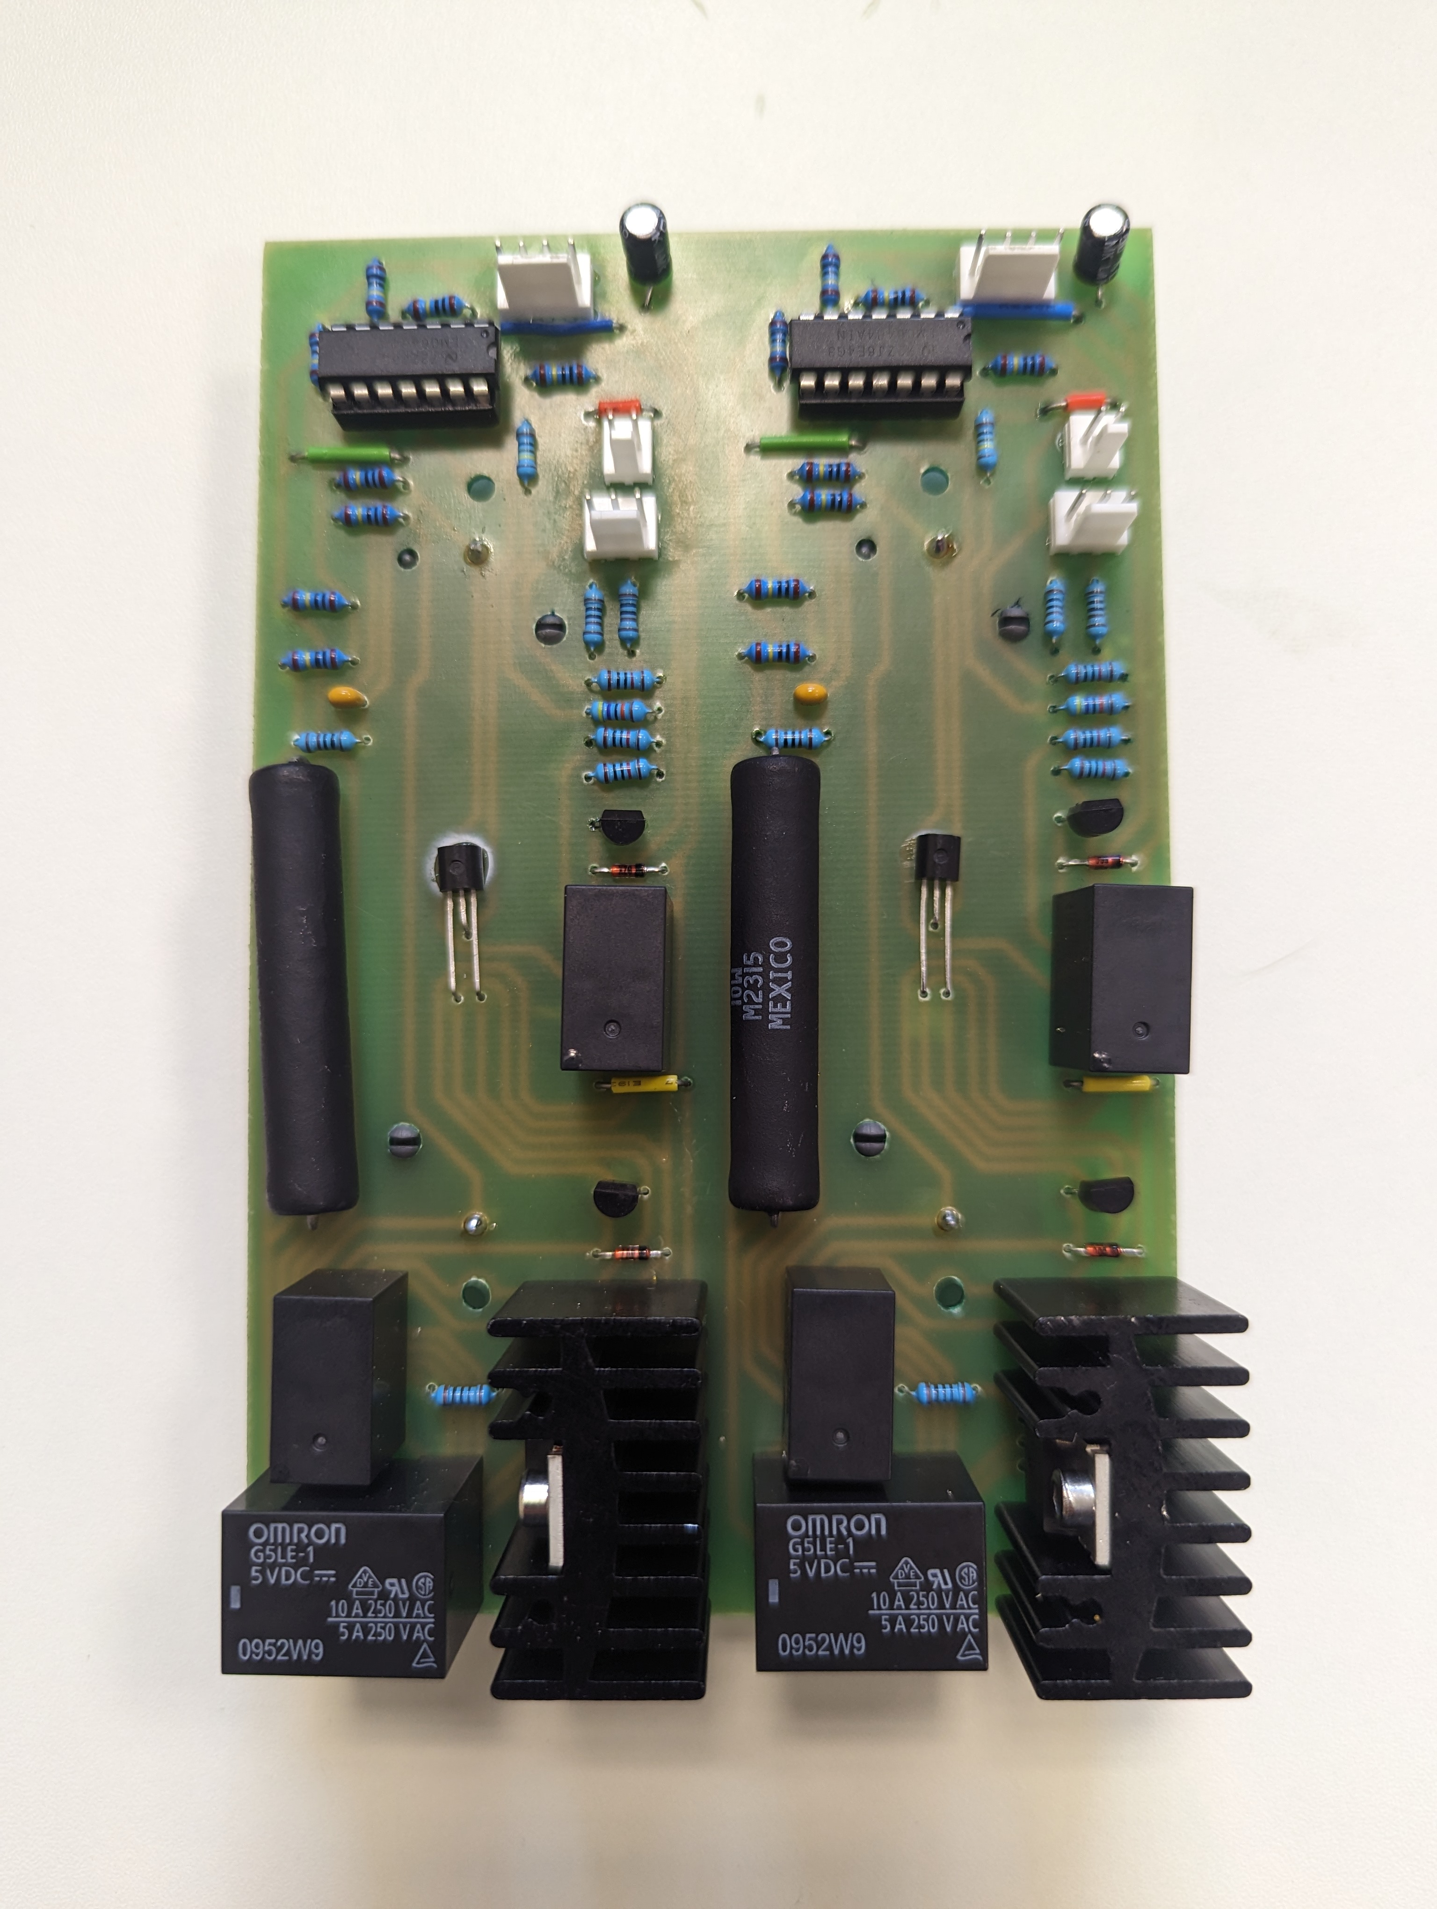
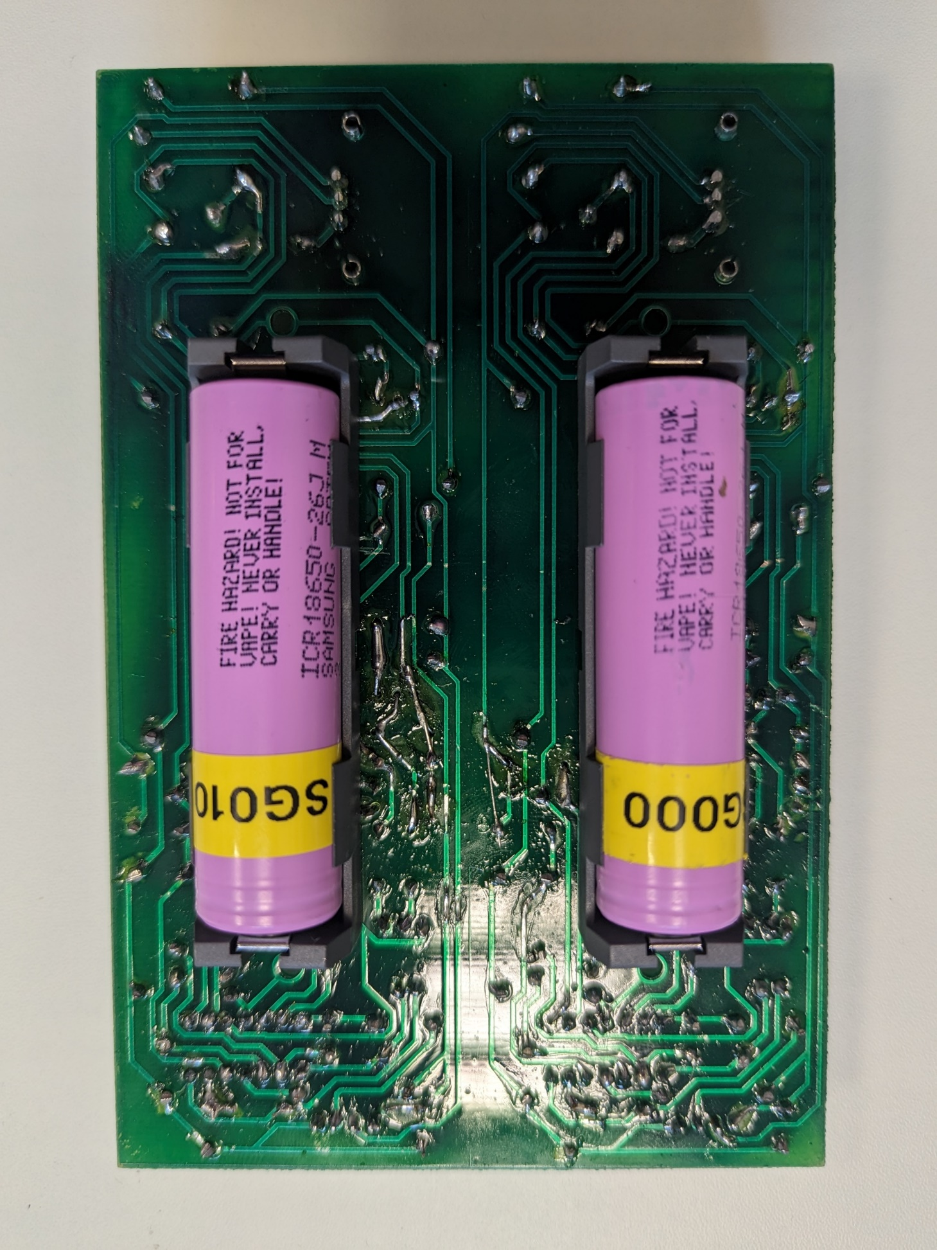
(Dis)charge boards
Control Connector
Temp Sensor
Charge Relay
MOSFET
Measurement Connector
Power Connector
Quad Op-Amp
Set Resistor
Discharge Relays
Cell Holder
Two circuits on one PCB
Notes:
Cell holder mounted on back of PCB.
Relays to switch on/off the charging and discharging.
Current Control using op-amp/MOSFET feedback loop.
Measurement of current, voltage, and temperature using op-amps

Slide 18
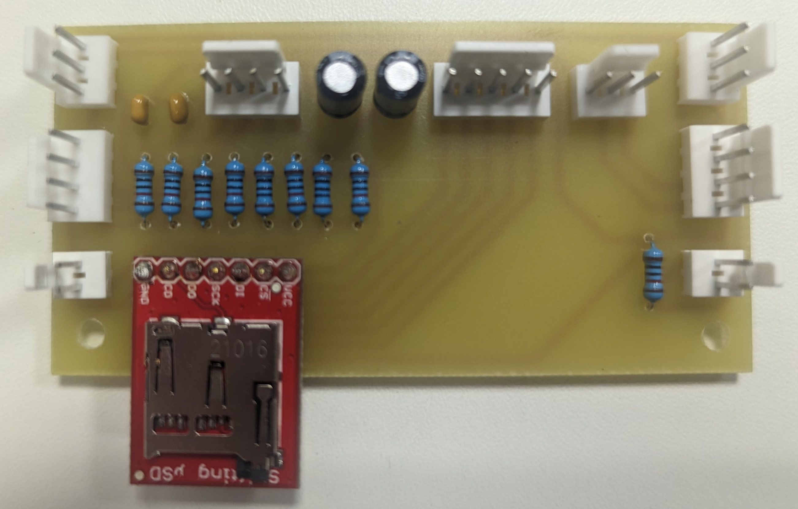
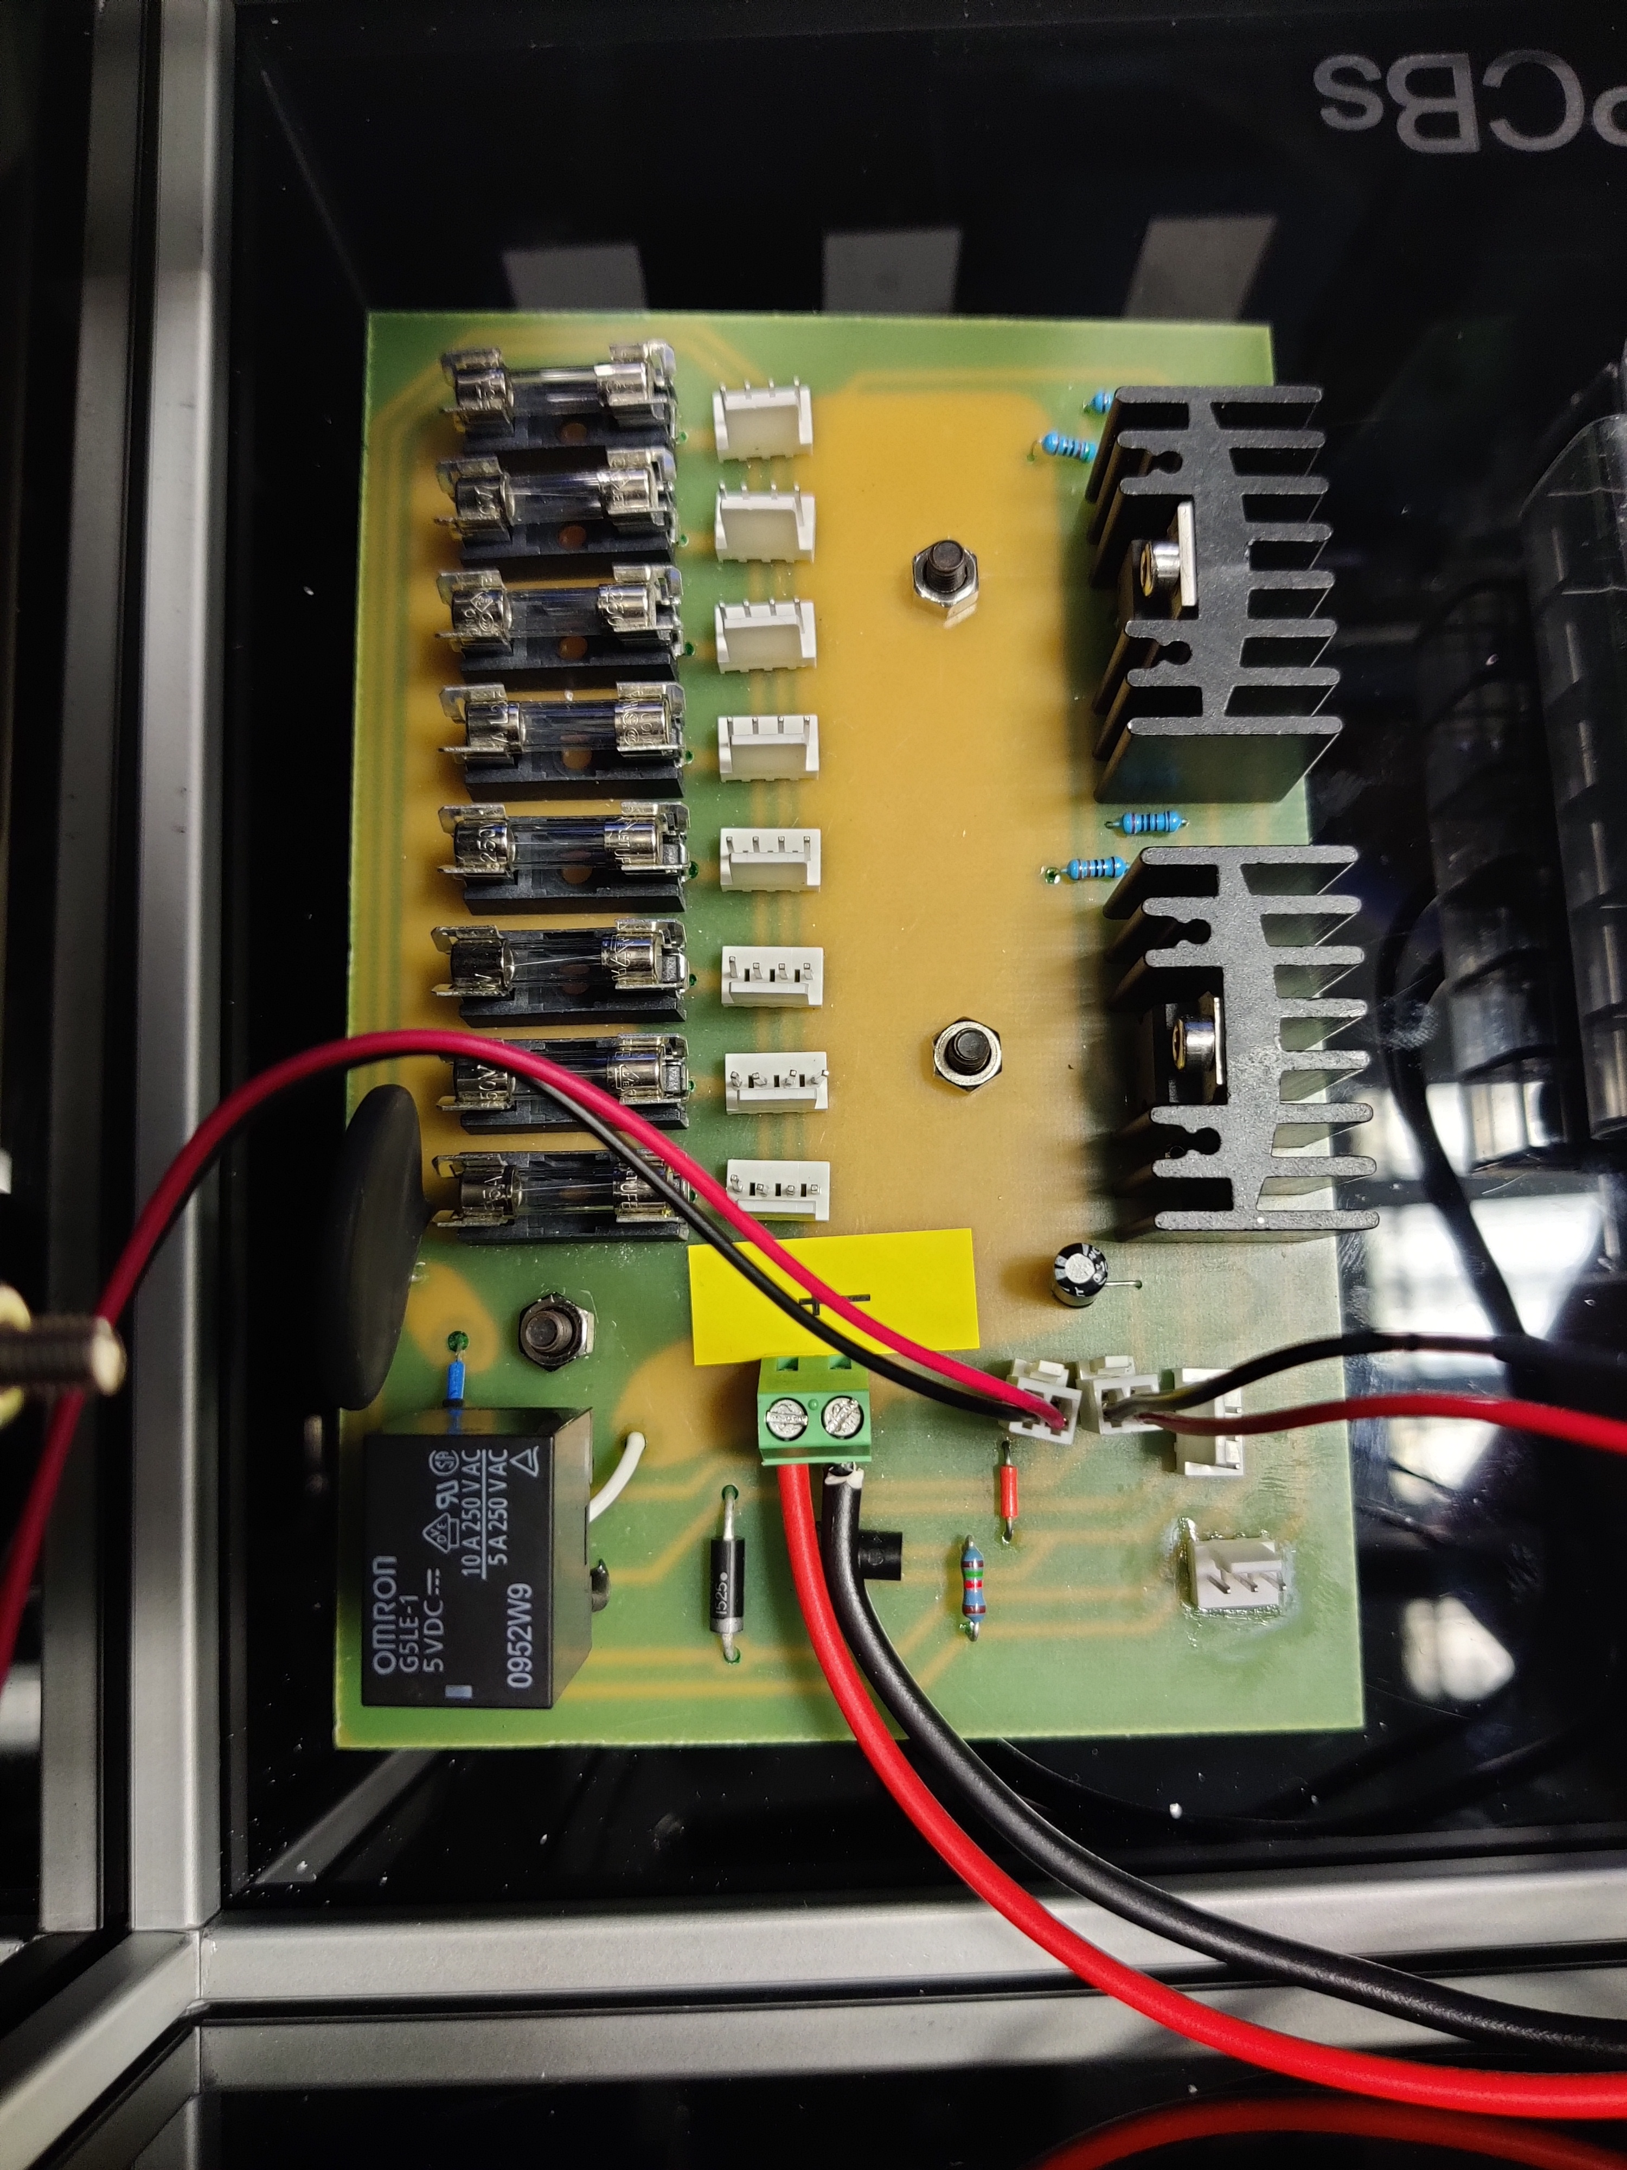
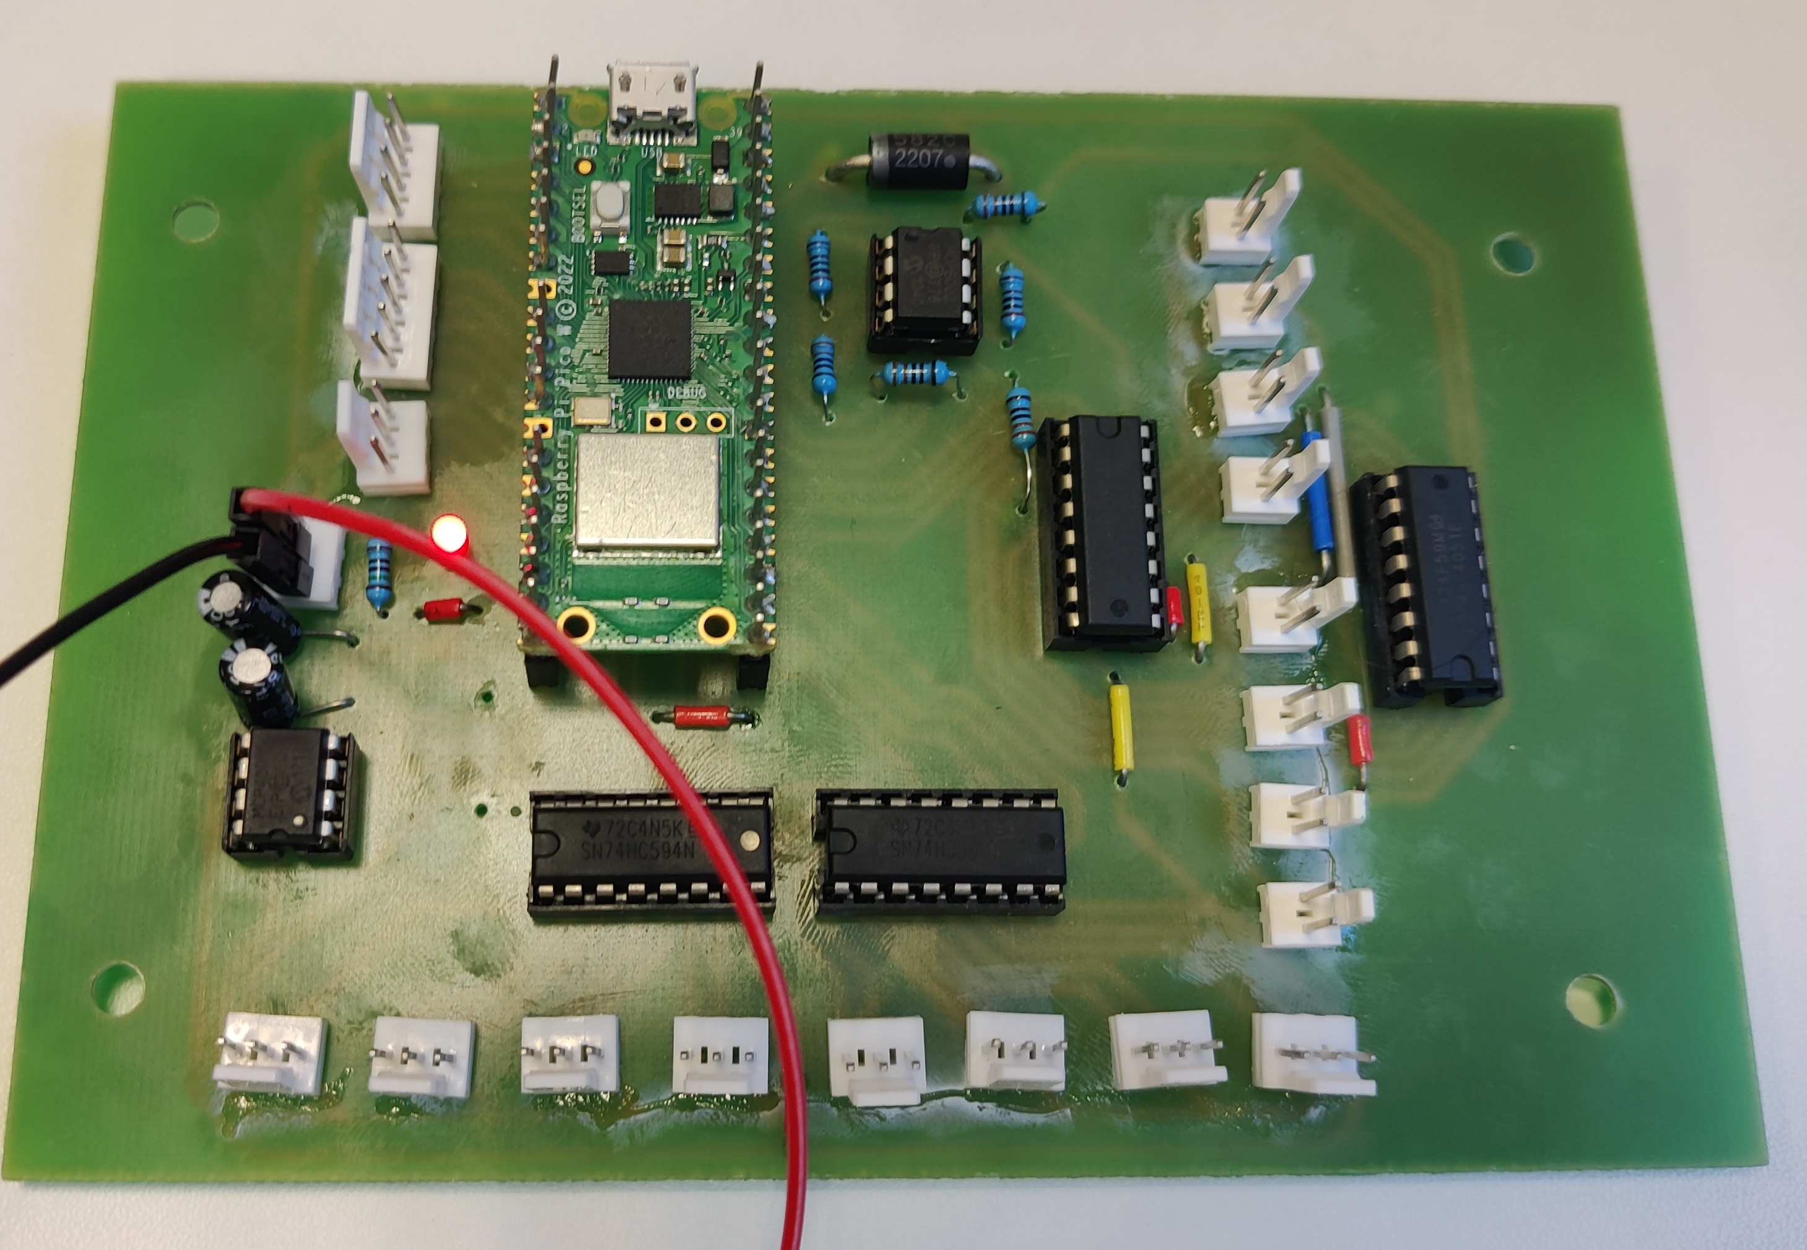
IO board
Power distribution
Control board
Notes:
The IO board serves to simplify cabling by grouping front panel connectors together.
SD Card Module for non-volatile memory, accessible from front panel.
Capacitors and resistors for debouncing buttons and rotary encoder.

Slide 19
Firmware
Start
Load Config
Structured as a state machine
Ensures robust, safe, logical operation
Key parameters set by config file (no coding required)
Pre-Check
Trickle Charging
Pre-Cycle Discharge
Data Logging
Charging
Discharging
End

Slide 20

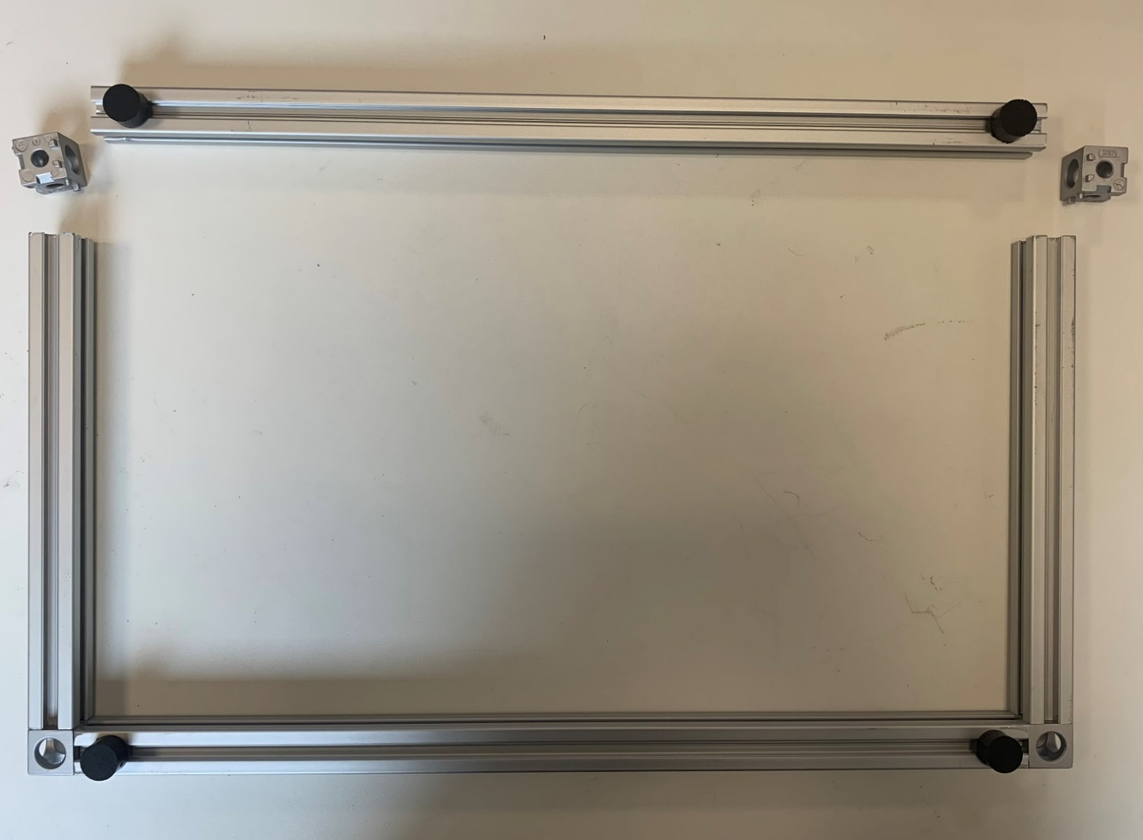
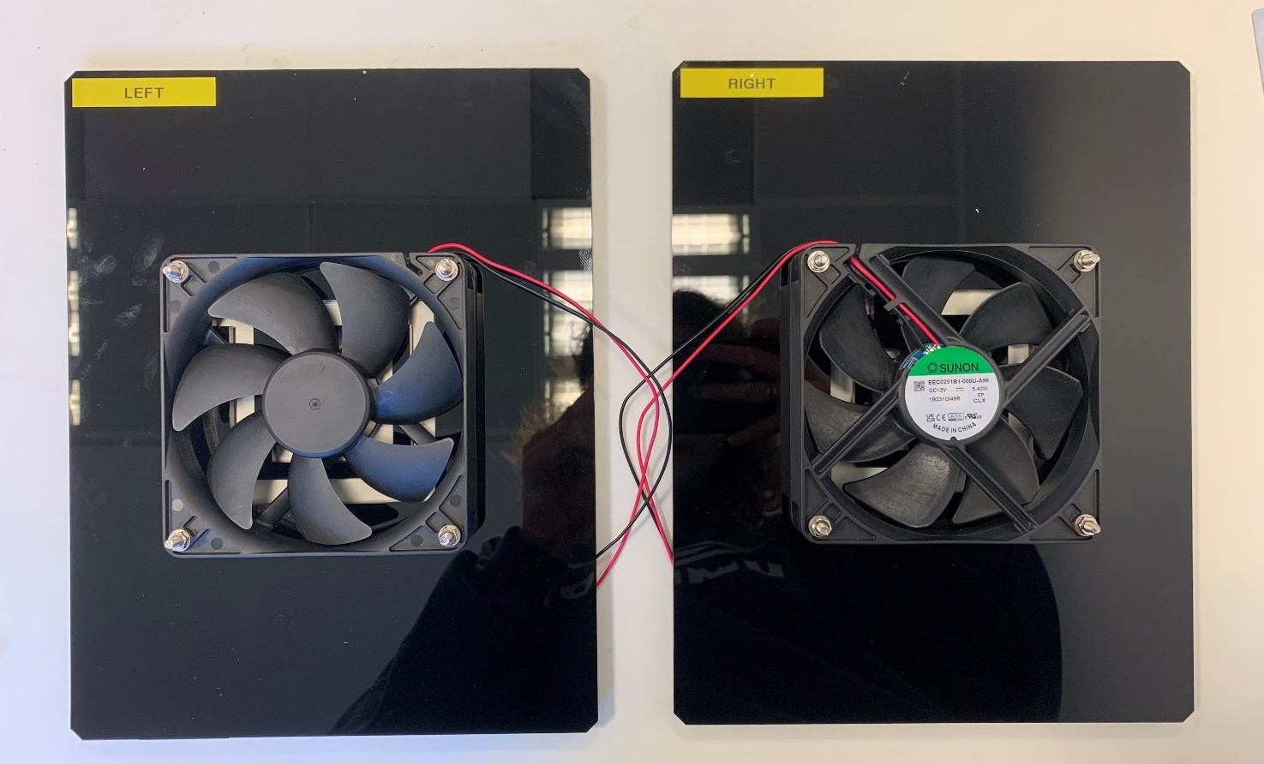
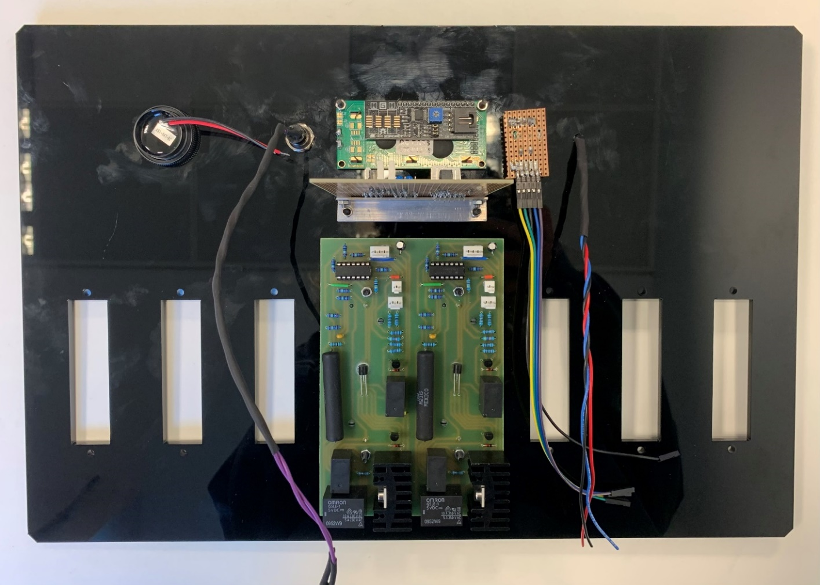
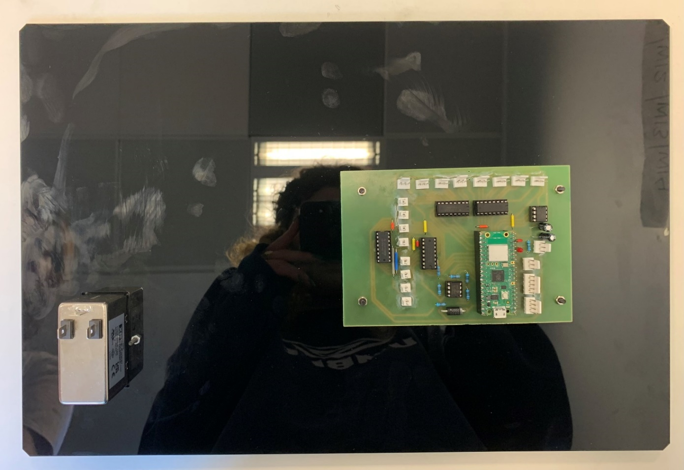
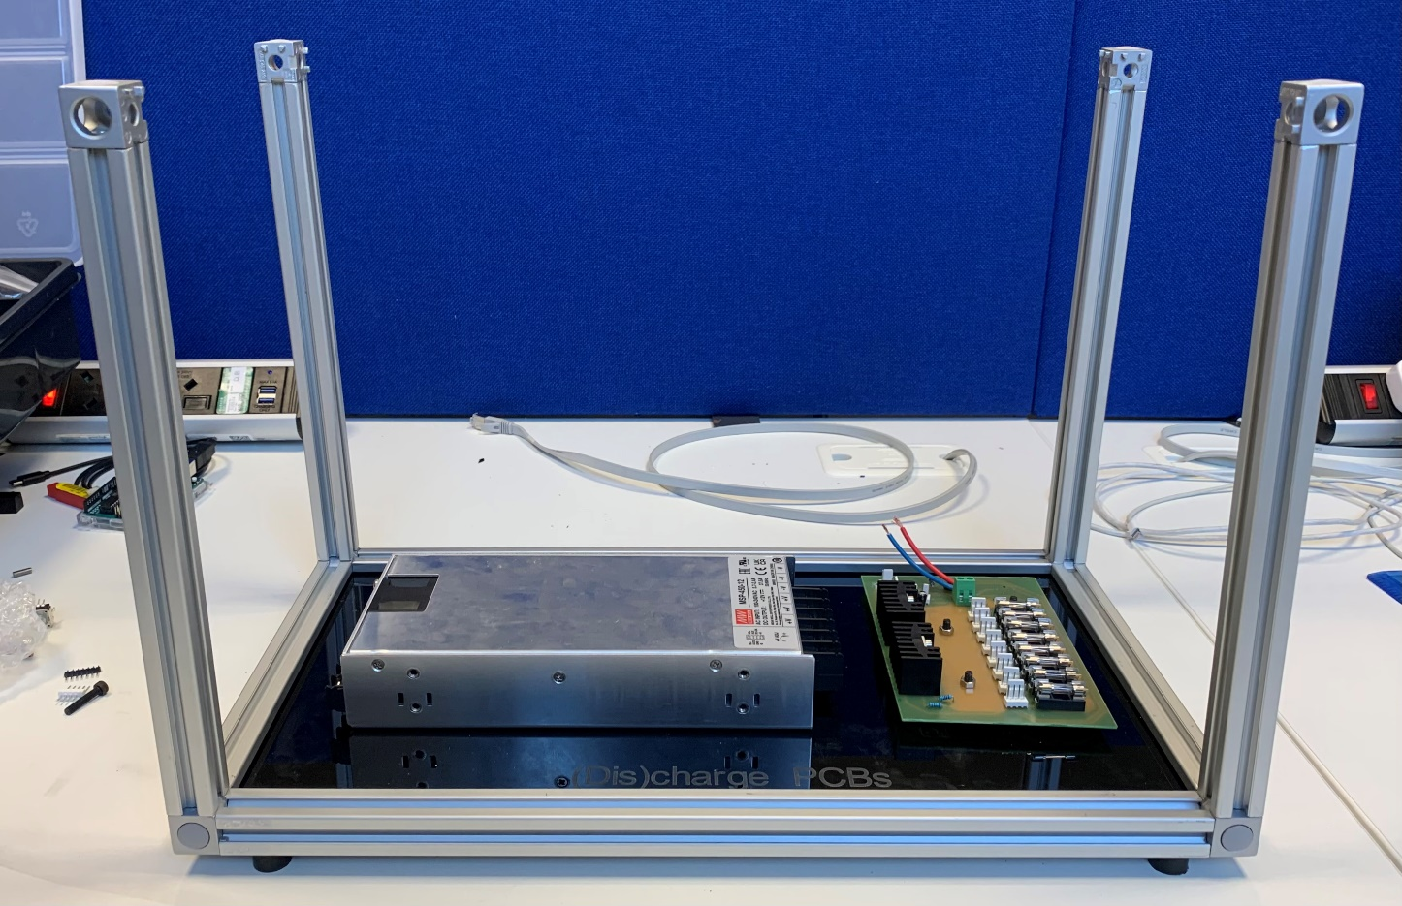
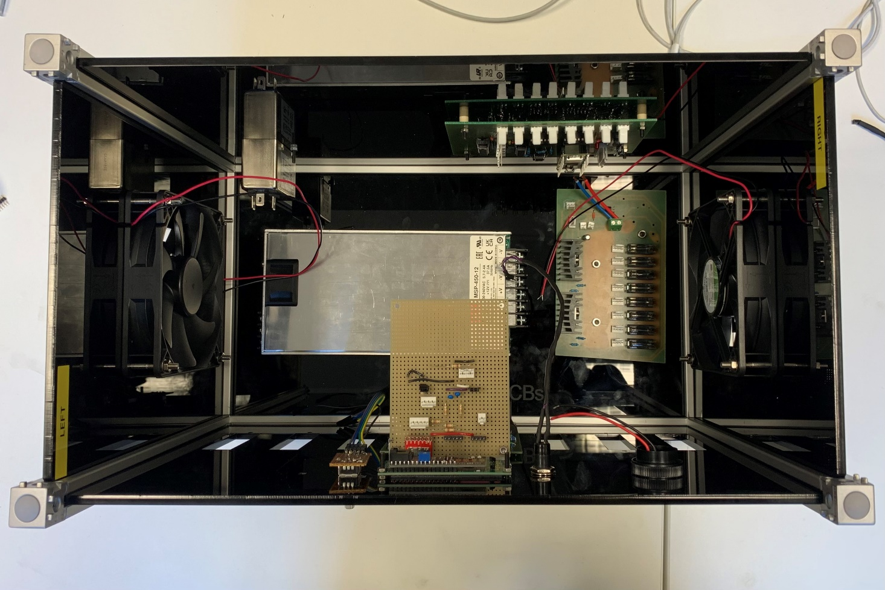
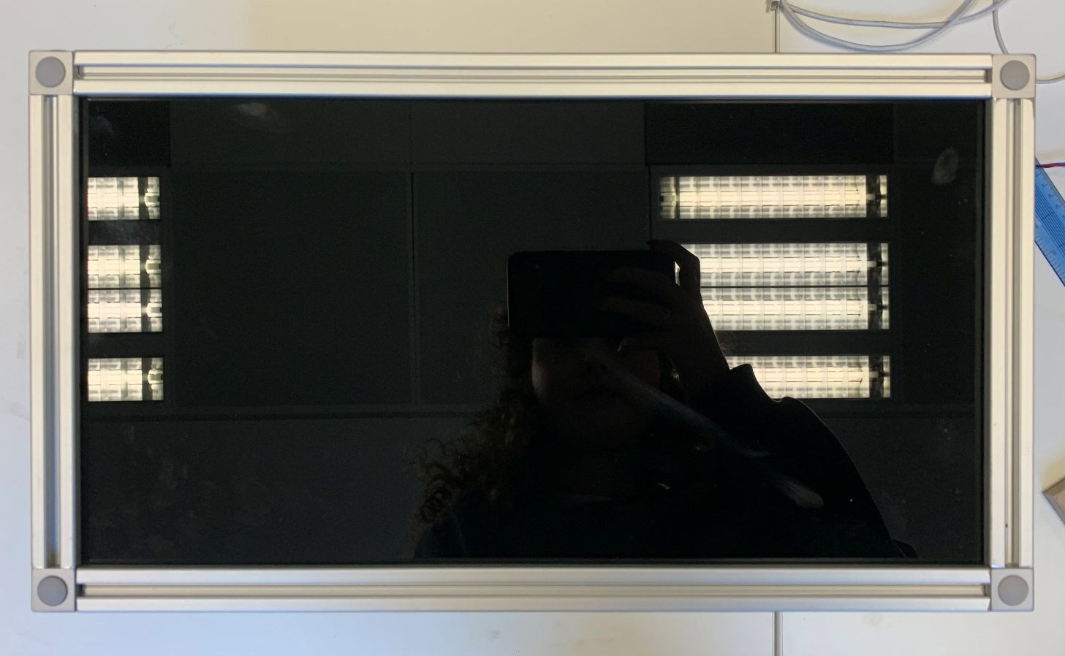
Assembly
Notes:
Back socket and control board
Power supply and board base

Slide 21
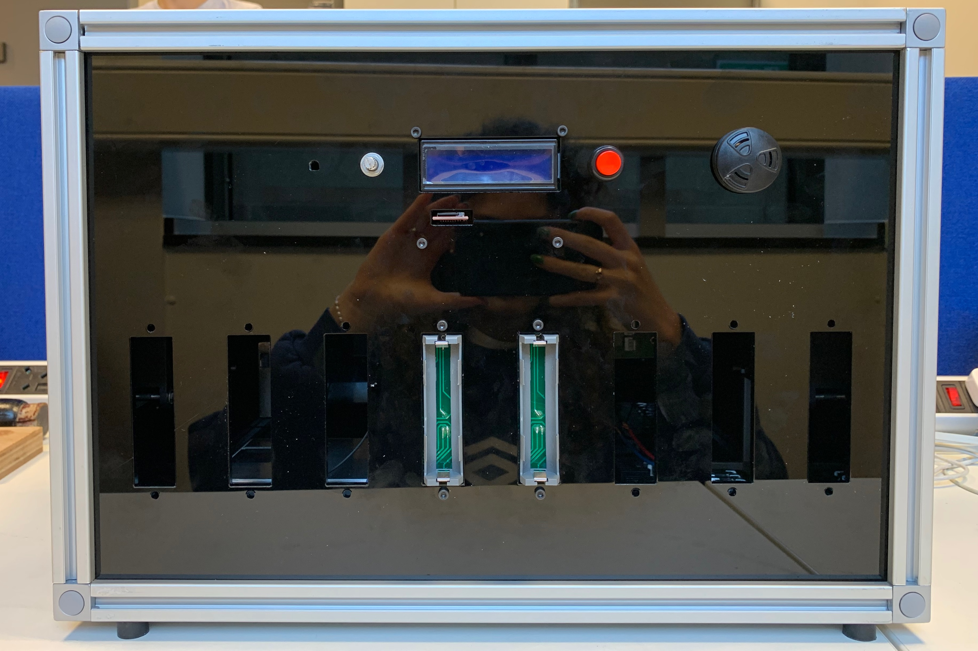

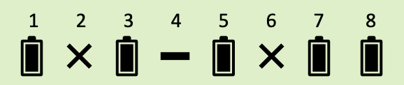
Assembled prototype
Rotary encoder
Confirm button
Temperature sensor
Buzzer
*Perspex can be very reflective ☺
Notes:
Screen: use rotary encoder to select
Red: confirm button, yes I want to do this
Temp sensor: ambient temp
Buzzer: buzzes if any cell exceed acceptable temp
Pretty large: 450 x 310 x 250 mm ish
Future: reduce dimensions and hence materials, which will reduce costs. Look into 3D printing, more cost-effective

Slide 22
Single-cell prototype
….

Slide 23
SOFTWARE

Slide 24
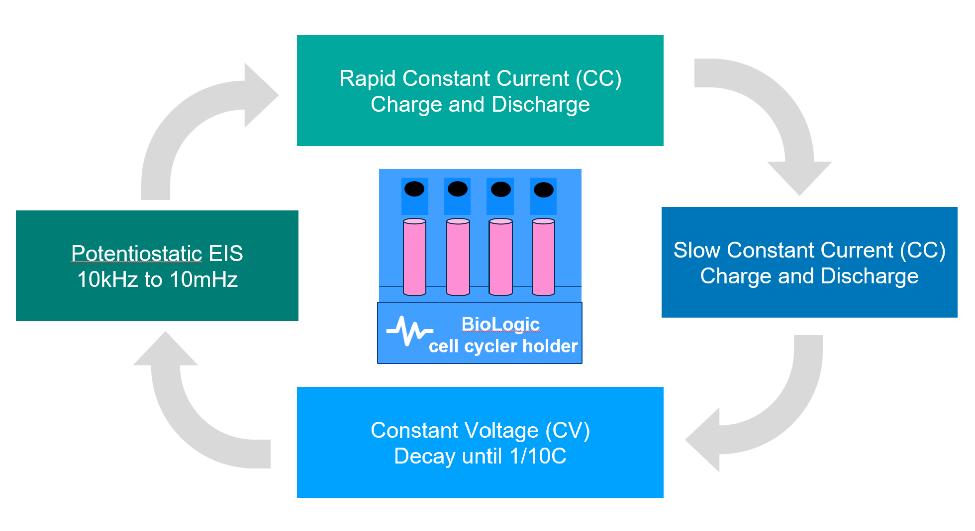
Battery cycling
ICA
dQ/dV
Feature 2 (Peak width)
Feature 1 (Peak height)
V (Cell potential)
Notes:
ICA, gradient between charge and voltage to build a curve, extract characteristic features
Cycle battery cells -> data-driven model
Open-source datasets
Use BioLogic cell cycler, eight slots
Three battery chemistries
Age, assess
Modify parameters for each cell
Incubator, battery cell behaviour <> temperature
Motivate why it’s important

Slide 25
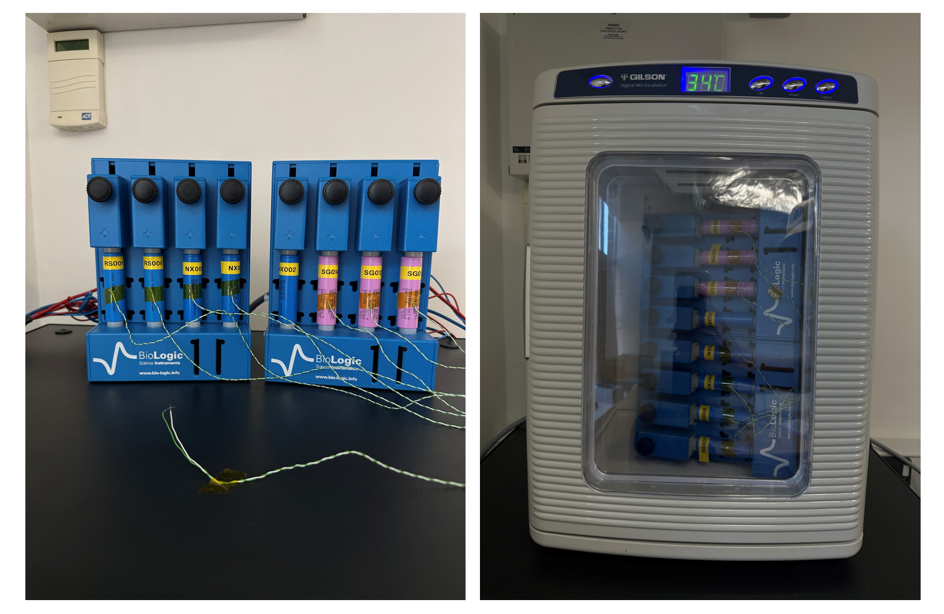
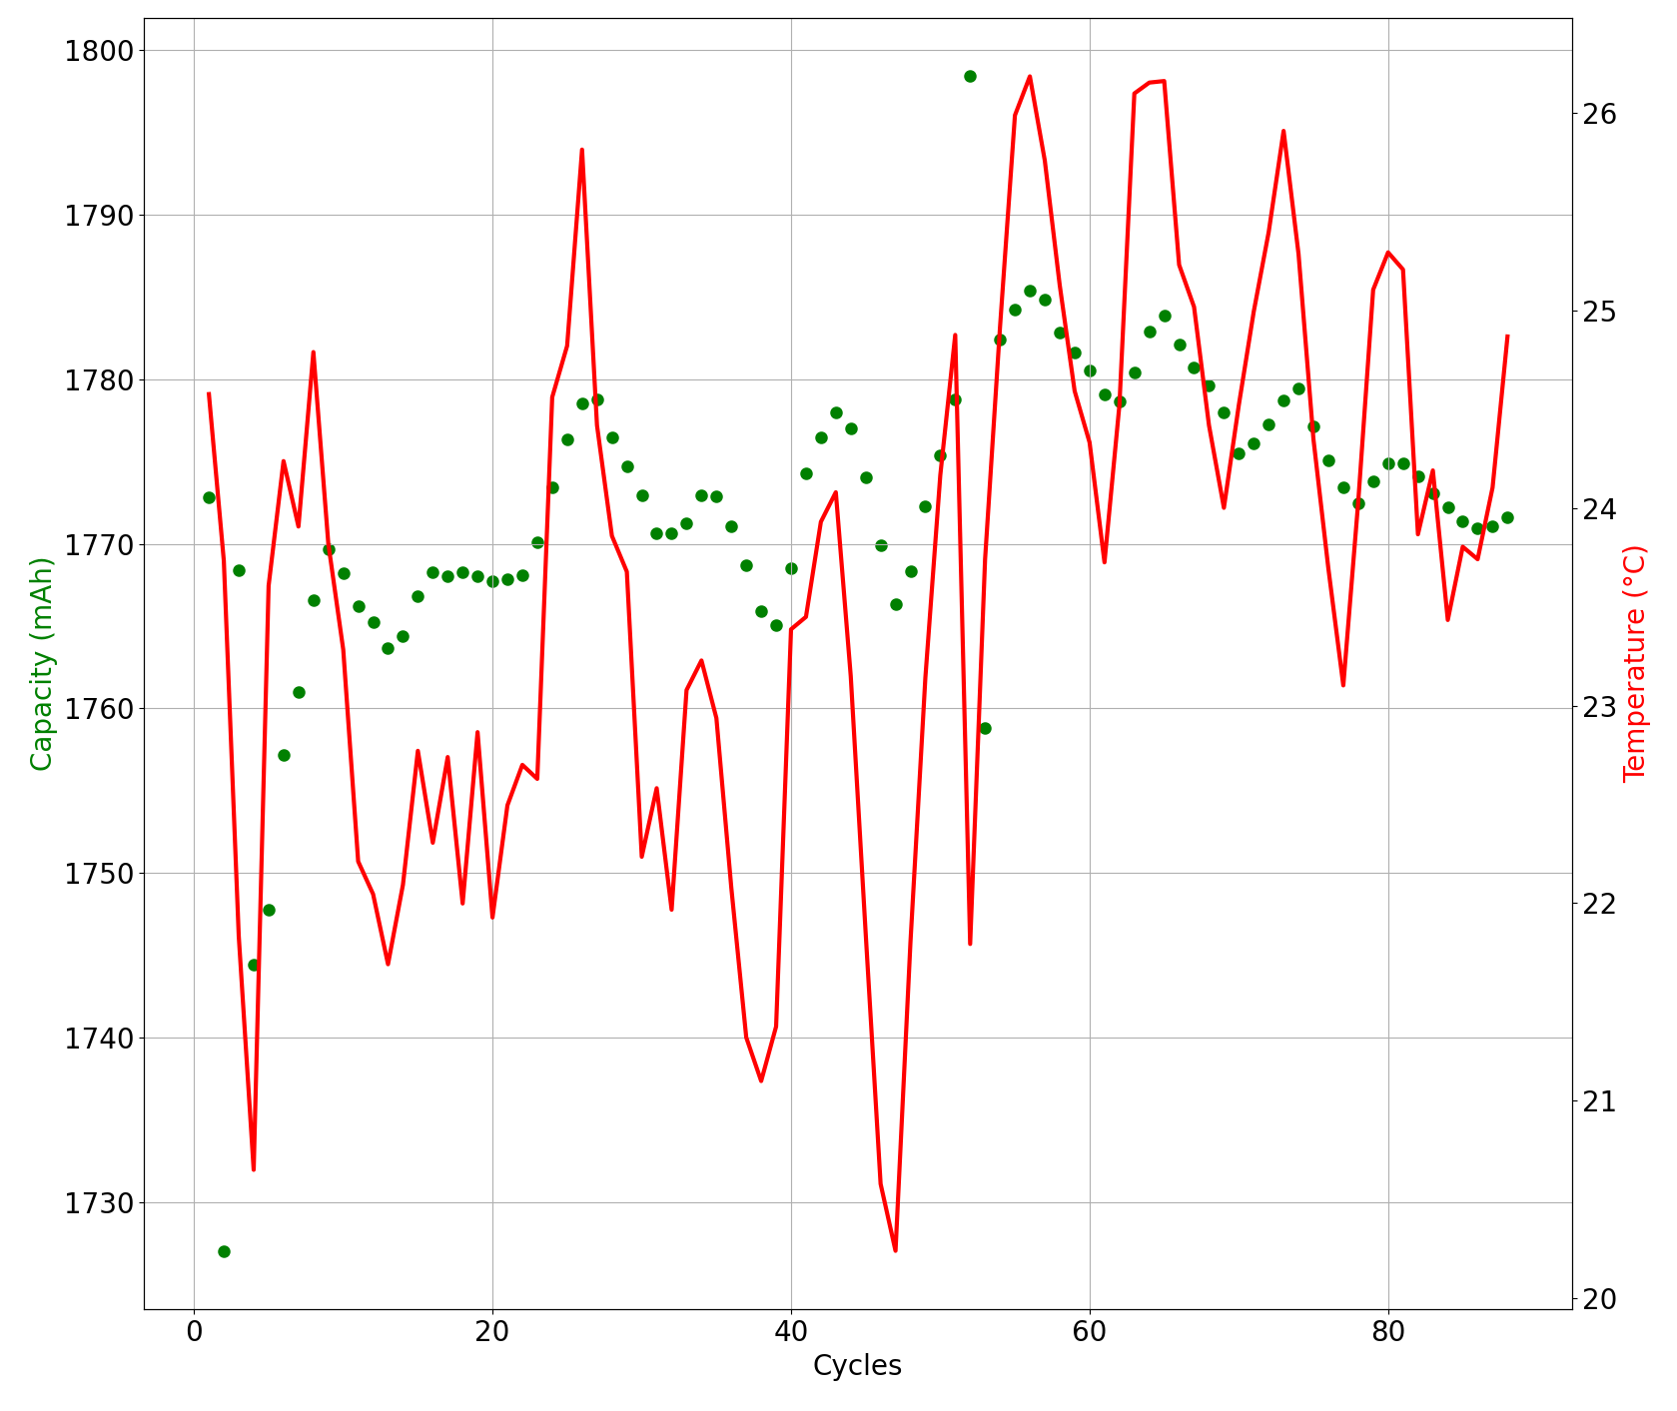
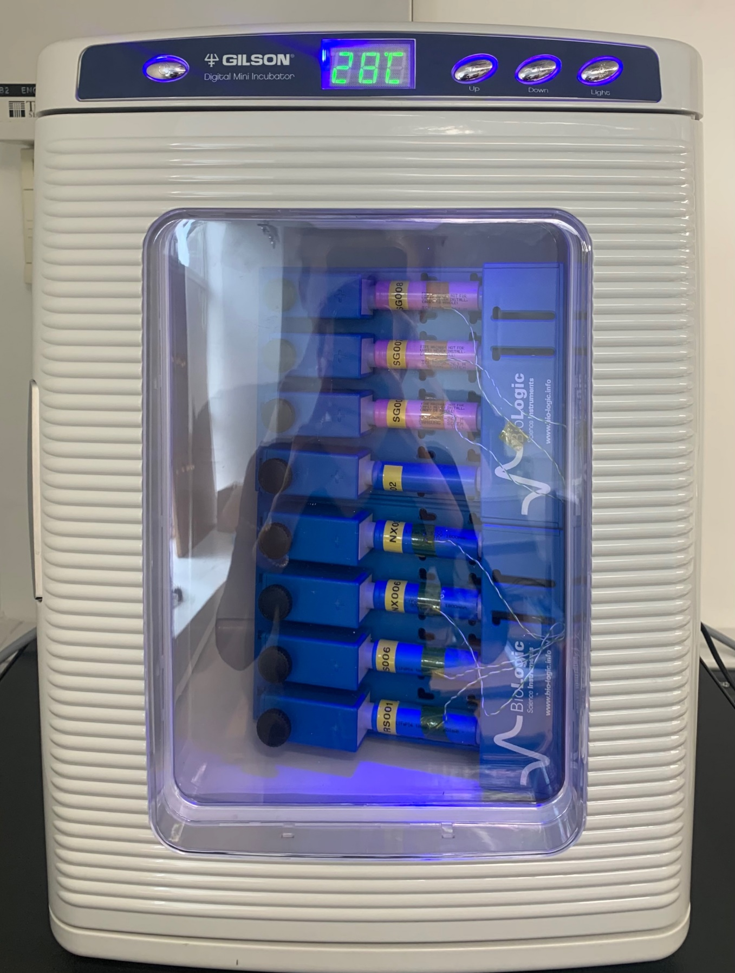
Battery cycling
Capacity (mAh)
Temperature (°C)
Cycles
Notes:
ICA, gradient between charge and voltage to build a curve, extract characteristic features
Cycle battery cells -> data-driven model
Open-source datasets
Use BioLogic cell cycler, eight slots
Three battery chemistries
Age, assess
Modify parameters for each cell
Incubator, battery cell behaviour <> temperature
Motivate why it’s important

Slide 26
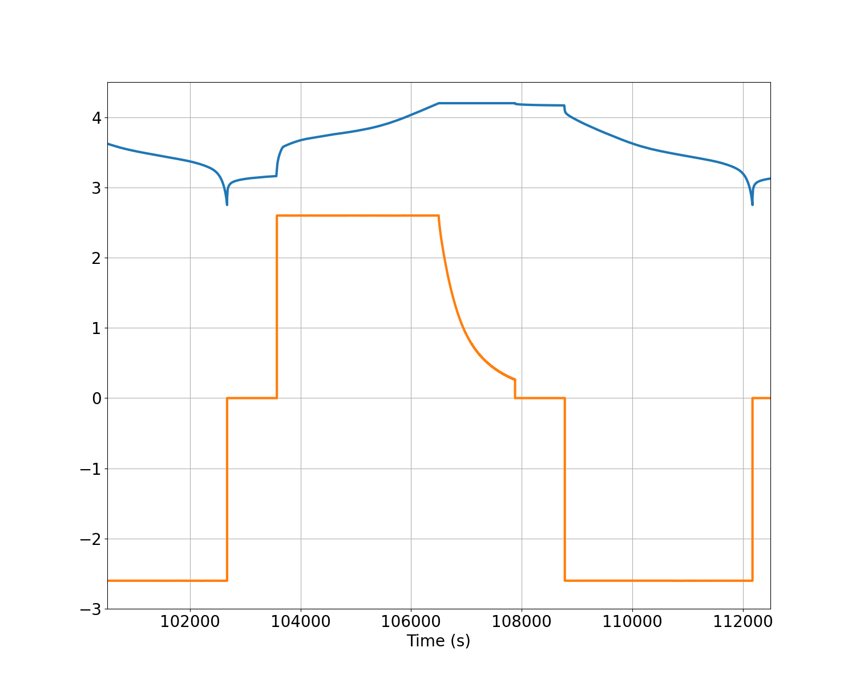
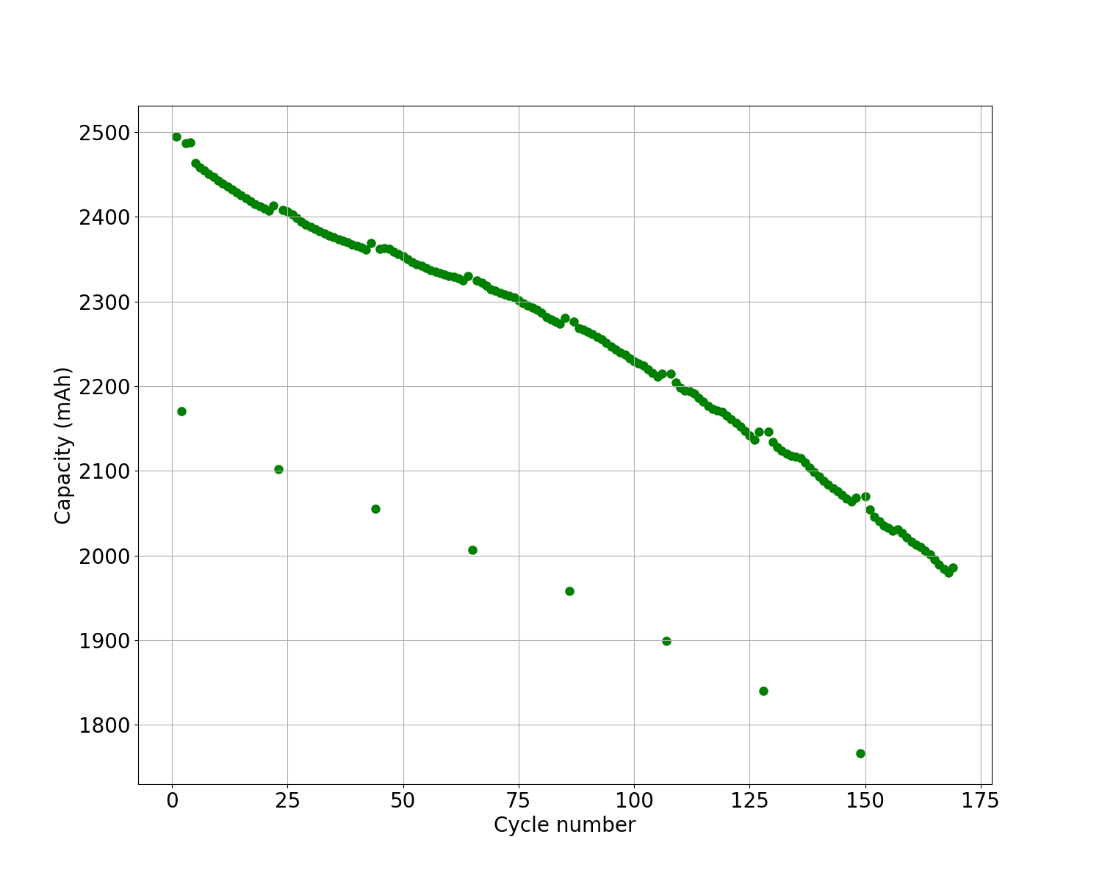
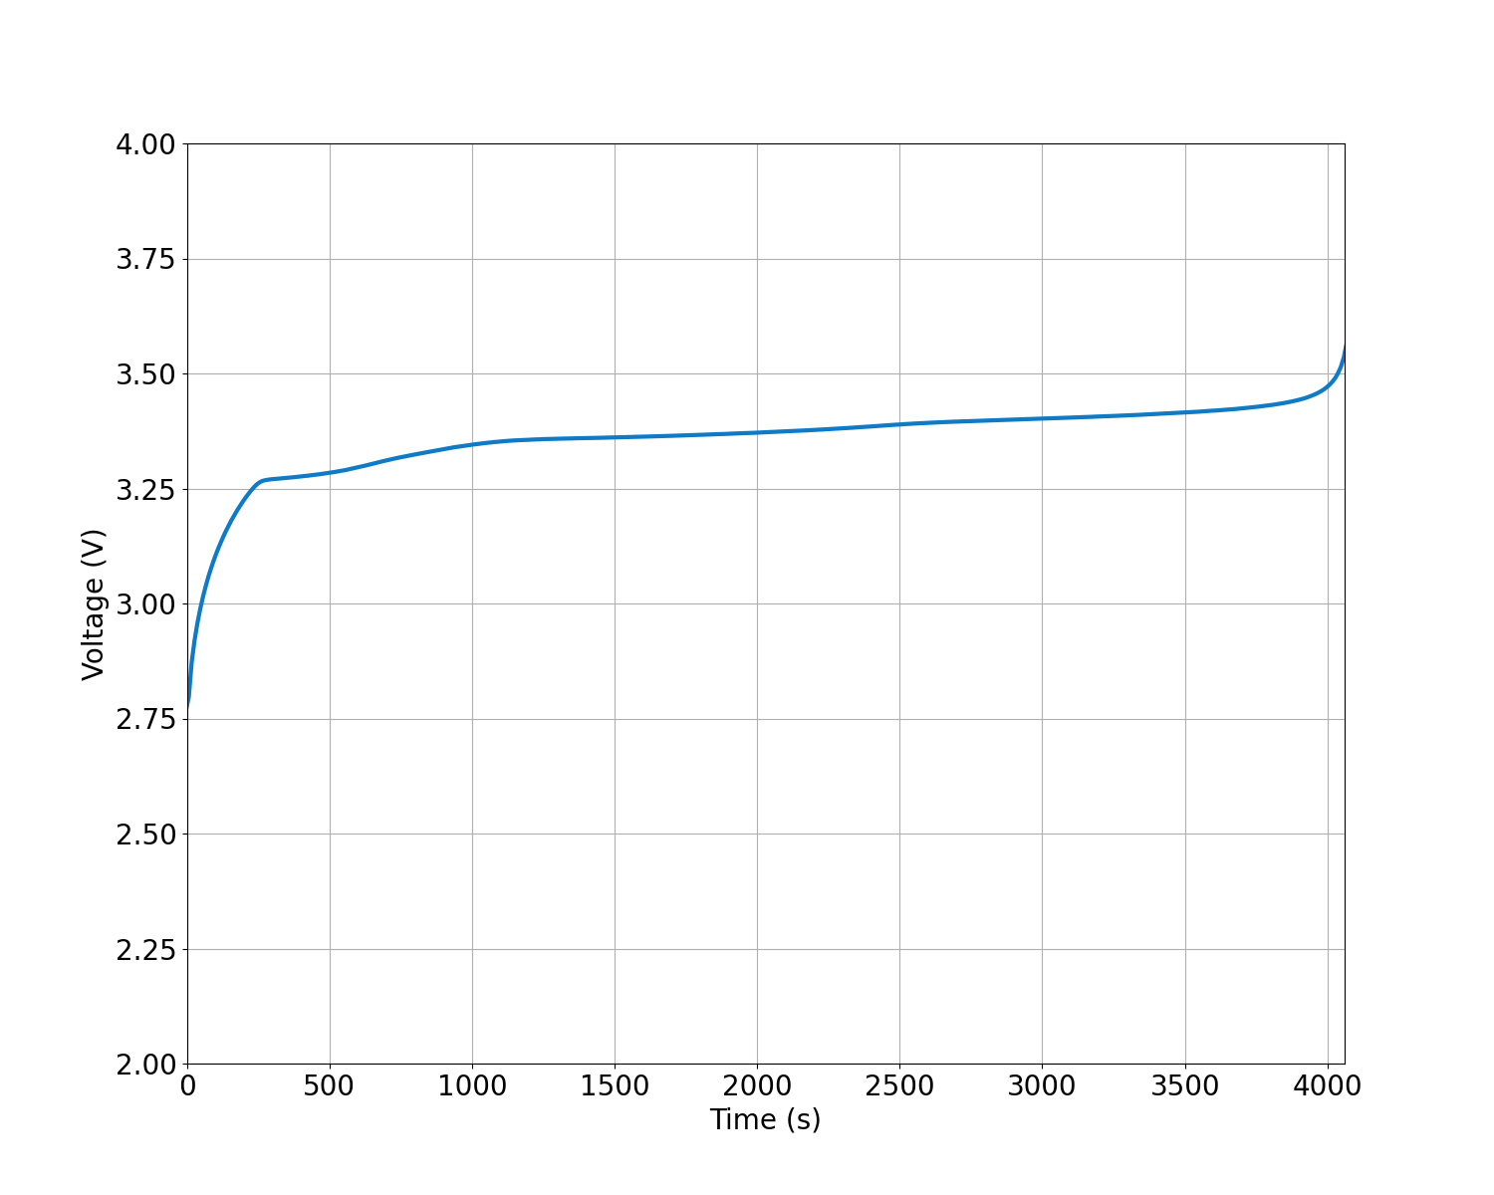
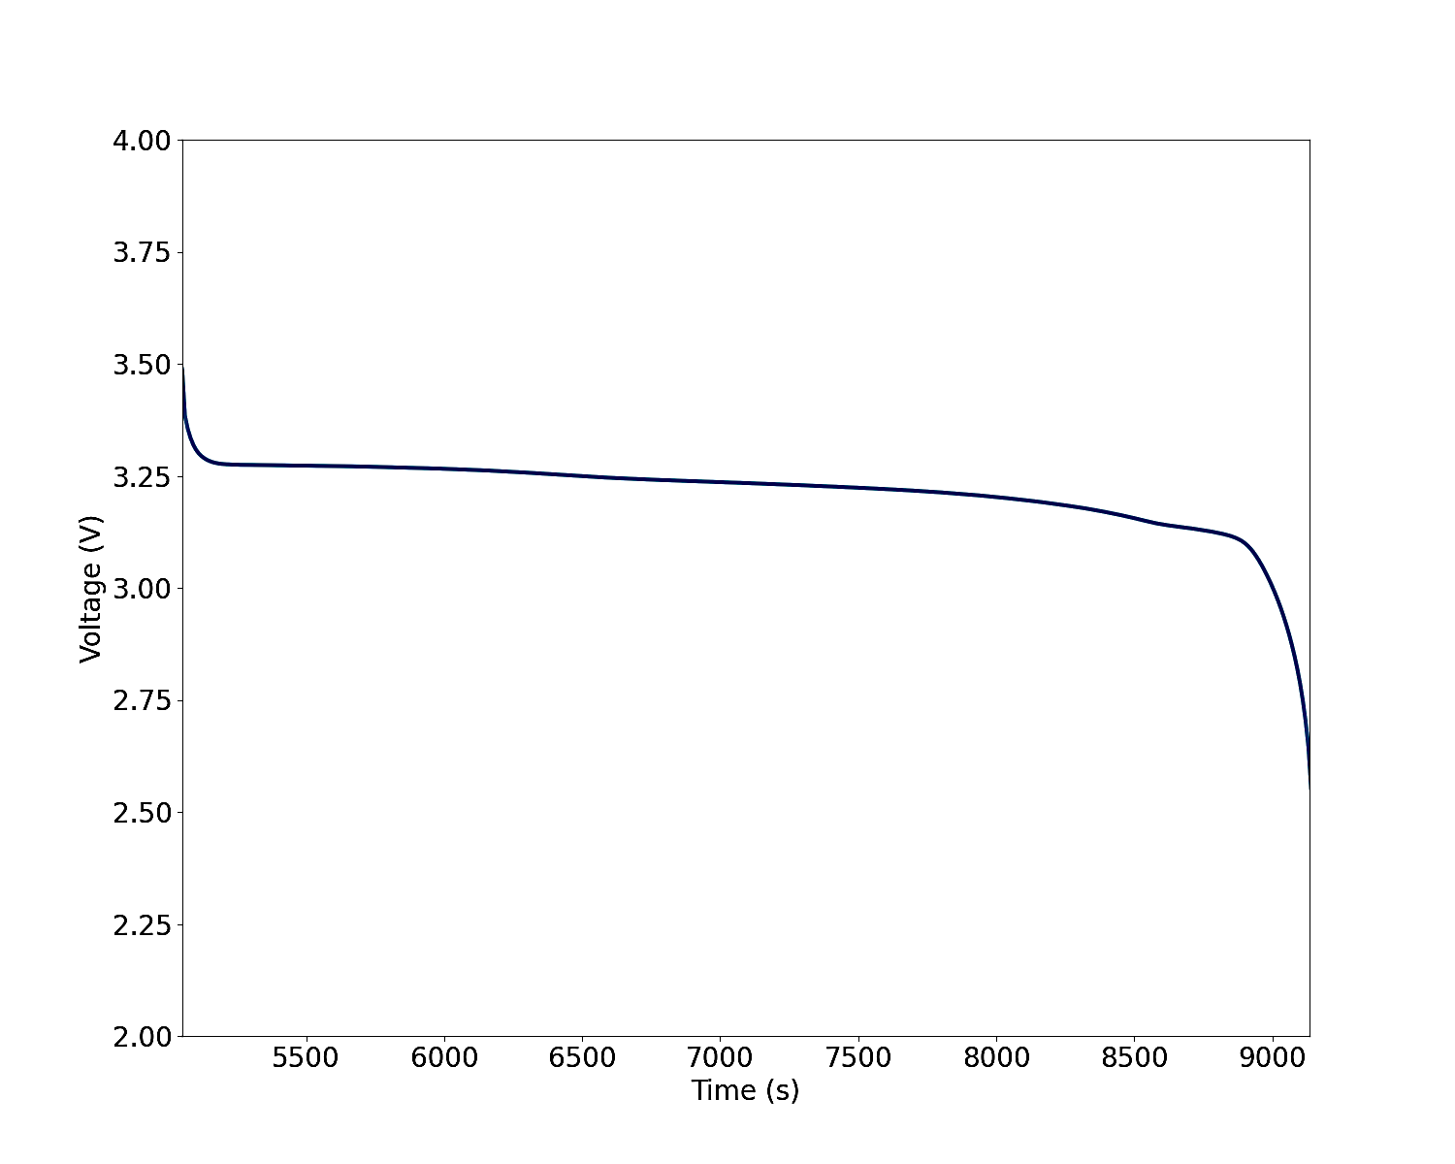
Battery cycling
Full Cycle
Capacity
Charge-Discharge
1
2
3
4
5
1
Cell Potential (V)
Charging
Discharging
Current (A)
Notes:
First image: Full cycle
Second image: Capacity, degrading to 77% of original SOC -> continue, expect to reach 30%, complete dataset

Slide 27
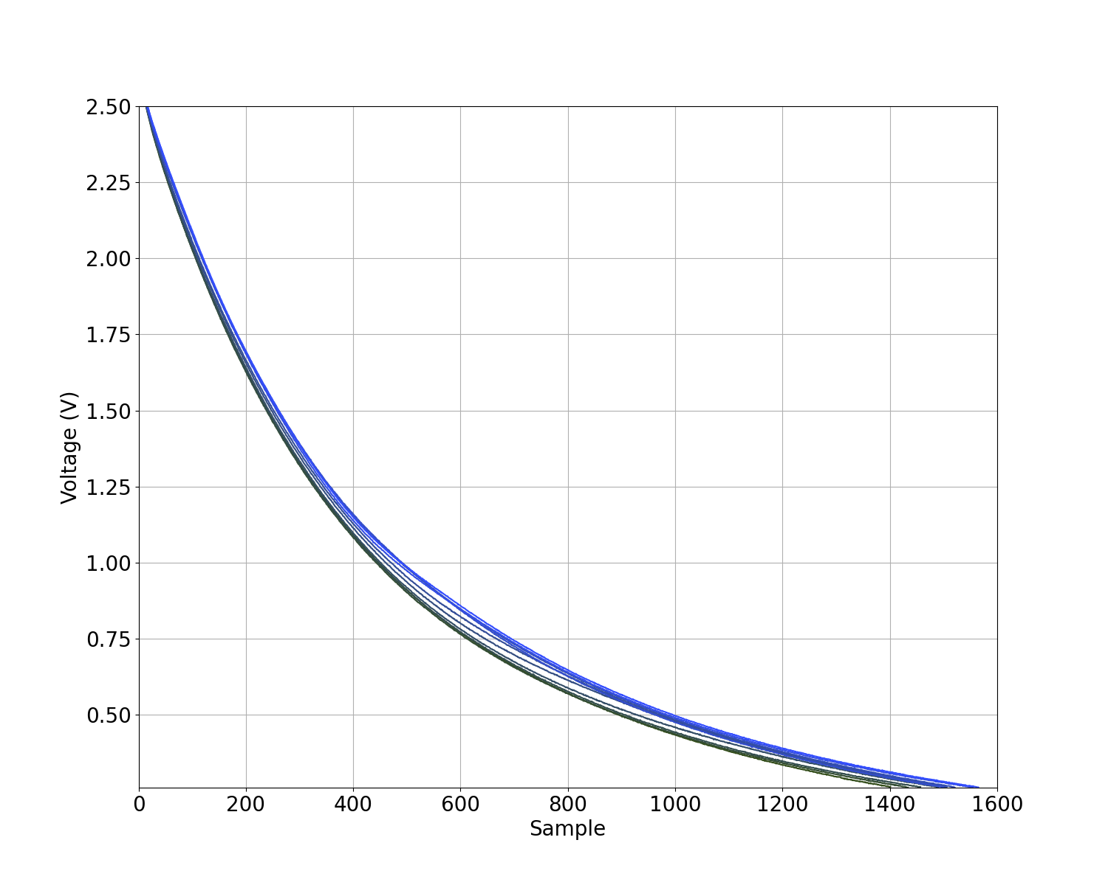
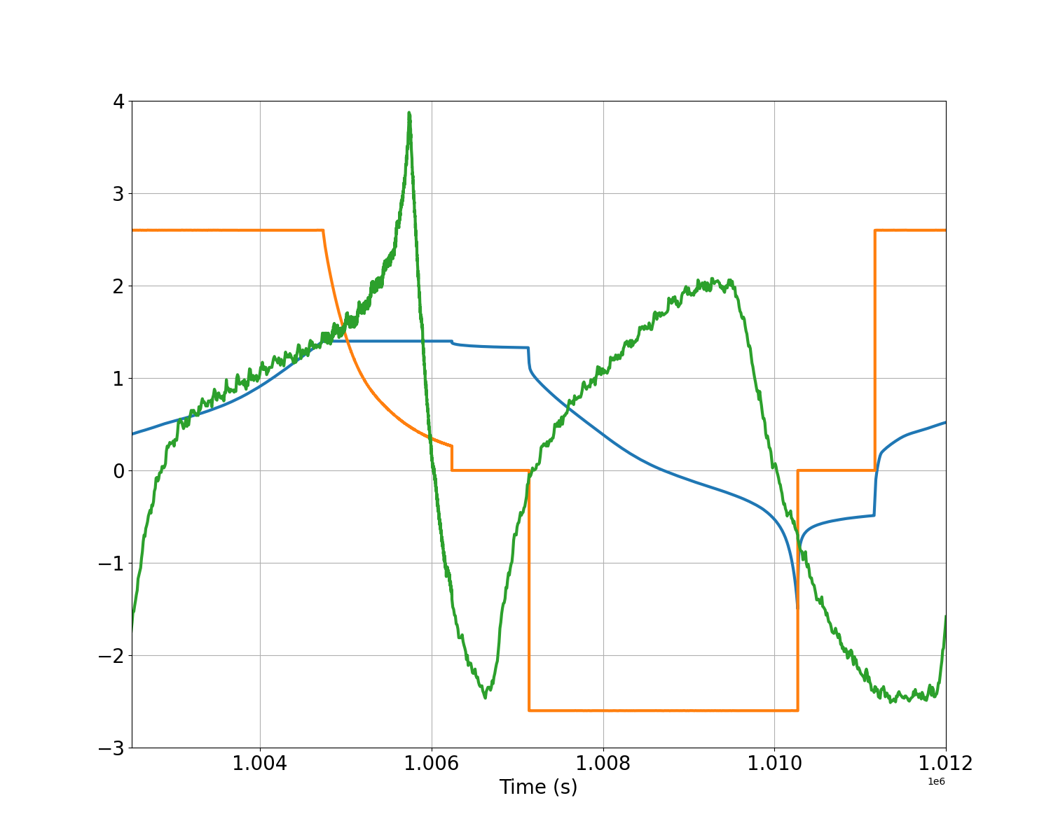
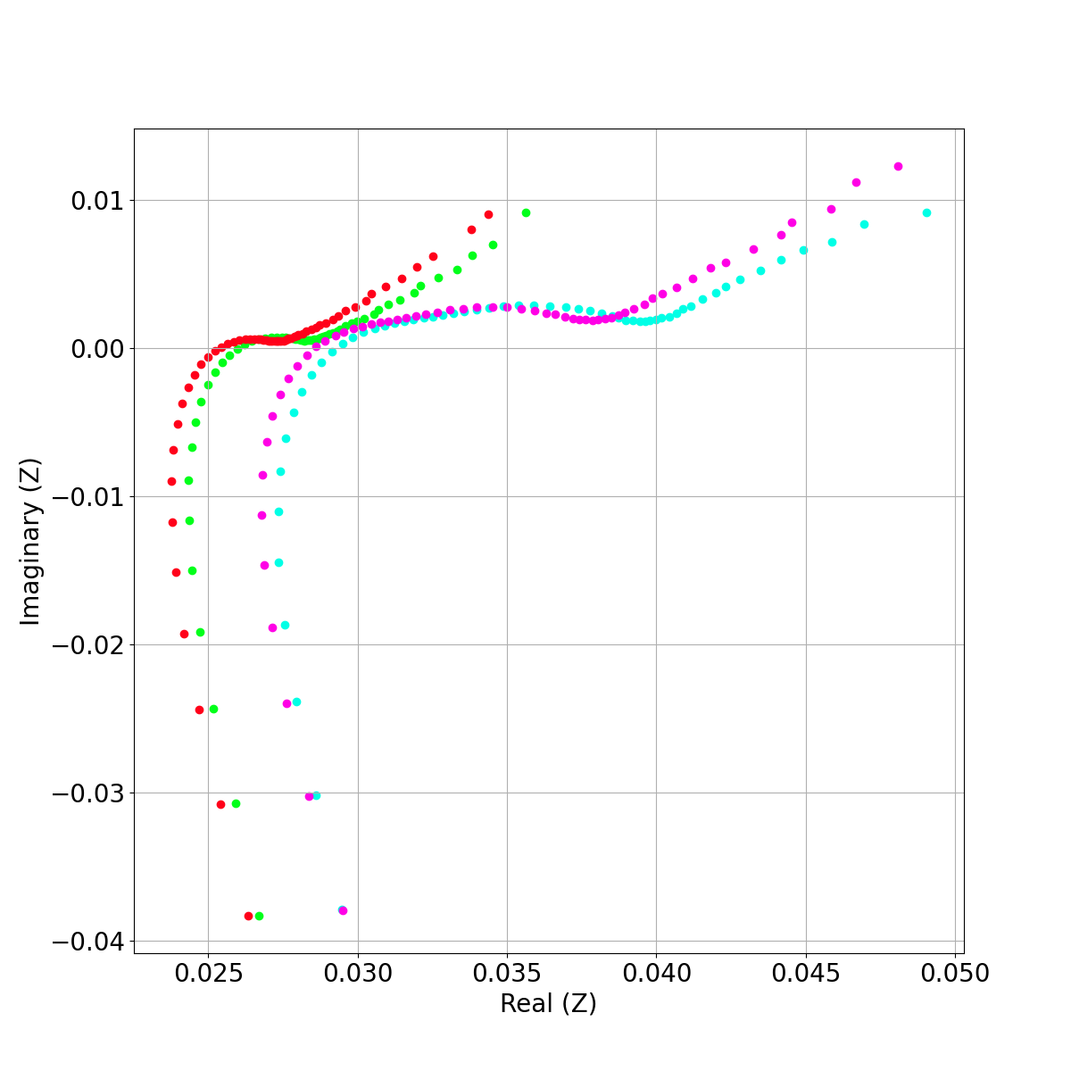
Battery cycling
Constant Voltage
Temperature
Potentiostatic EIS
Norm. Temperature (°C)
66%
Current (A)
66%
Norm. Cell Potential (V)
33%
33%
# Cycles

Slide 28
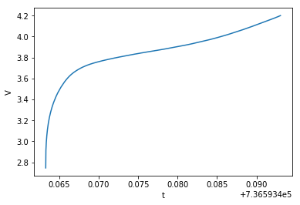
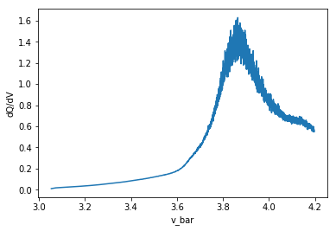
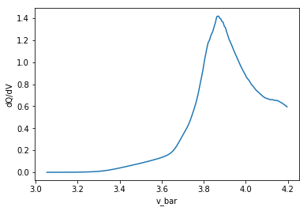
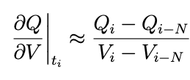
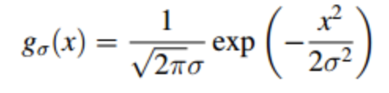
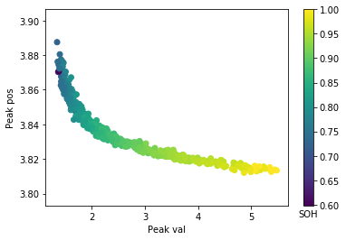
Feature Selection
Feature Selection
Charging cycle
1st order derivative approx.
1D Gaussian filter
Chosen features
Oxford Dataset Features
In Literature?
Gaussian Process Models
Kalman Filters
SVM
Deep Learning
Peak
Peak value
Peak position
Notes:
1. The raw cycling data was first processed numerically before key features were extracted. The dQ/dV ICA curves were approximated numerically, and a standard 1D Gaussian filter was implemented for smoothing. This was chosen to remain simple to implement and understand.
2. Based on the current literature, the key features chosen were the ICA curve peak value and peak position. The middle figure shows a nice clear trend using these features when plotted against SOH. From the models used in literature for SOH health approximation, we chose a Gaussian process model for two reasons: (i) nice trends in data suggest regression is a sufficient to capture relationship between SOH and key features, (ii) a very well-maintained toolbox in Python for Gaussian Processes allows easy implementation for 3rd party users.

Slide 29
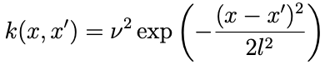
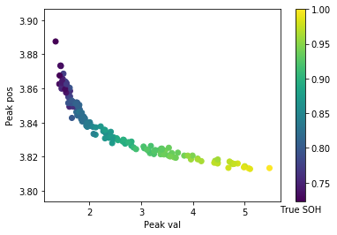
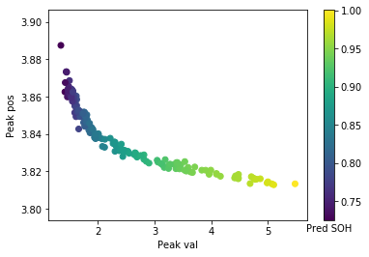




Model Validation
Gaussian Process model
SE Covariance function - smoothness
Oxford True
Oxford Predicted
Oxford Mean Error
NASA True
NASA Predicted
NASA Mean Error
Notes:
GP model was trained using a squared exponential covariance function (means we expect data to be smooth rather than e.g. periodic or random etc). Other covariance functions were tried and tested but no significant advantage over simplest version of squared exponential
What makes our model different to others in the literature is that we combined both features into one model vs literature trains a separate model for each feature and combines them at the end.
The model was trained and tested on oxford and Nasa datasets – and performed better than the current results in the literature. Very low mean error (as seen in right hand panel).

Slide 30





Software Package
Feature selection
ICA parameters
GP model training
Error analysis
Notes:
A software toolbox built on the top of GP toolbox. Further abstraction from the maths allows for 3rd party users to quickly train GPs for SOH approximation.
Initial results are shown for Samsung dataset using this toolbox. The code screenshots have been placed here to emphasize the simplicity of using this toolbox.
Top right figure shows that toolbox is exploring a third feature – peak width by fitting a Gaussian to ICA curve. This means that there are more features that must be explored to further optimise the model.
Bottom right shows possible avenues of research. E.g Maybe using ICA curves to probe further into degradation mechanisms.
I will now pass on to Tomas to discuss the app.

Slide 31



Mobile app – technical considerations
Cross-platform
Sub-$100 phones
Customisable
Notes:
Must look professional and be easy to use
Must work on both Android and iOS, including sub-$100 Android phones
Additional platforms (such as desktop operating systems) are a big plus
Must be easy to edit by a typical software developer in LMICs
Ideally, editing should require only a royalty-free development environment and low-cost computer
Must be well documented for both users and developers

Slide 32

App – Navigation Drawer

Slide 33

App – Available devices

Slide 34


App – Active tests – In progress
Notes:
What the device is doing

Slide 35


App – Active tests – Done

Slide 36


App – Past tests

Slide 37
OUTREACH
Notes:
Multiple channels

Slide 38





The website – technical considerations
Must look professional and include engaging visual elements
Must work on both mobile and desktop devices (i.e., responsive design)
Must be easy to edit by a non-professional software developer
Plain HTML, CSS, and JS
TypeScript and Vite
React
Next.JS
Svelte
Notes:
Must look professional and include engaging visual elements
Must work on both mobile and desktop devices (i.e., responsive design)
Must be easy to edit by a non-professional software developer
Ideally, editing should require only a web browser and simple text editor, not a comprehensive Node-based build system

Slide 39


LifetimeCambridge.co.uk

Slide 40



Open-Source Documentation
CERN-OHL-P
GitHub
GitBuilding

Slide 41







Social media
@lifetimecambridge
@lifetimecamb
https://www.linkedin.com/ company/lifetimecambridge/
Notes:
Melissa

Slide 42


Future work
Hardware
App
Software
Outreach
Single cell prototype
Device refinement
Improve model with our dataset
Further cultivate dataset
Policy discussions with KEBS
Development i-Teams
Co-creation workshops with collaborators in Kenya
Notes:
Refinement: improve noise, operating parameters
Future work:
Added Complexities
Filtering methods
ML/DL models
Spectral features
ICA for degradation method
Software: Time series data in app, Further cycling data for other cell chemistries, ICA <-> Degradation mechanism
Outreach:Workshop with collaborators, Conferences, Newspaper article raising awareness, Newsletter circulation within the University
Policy

Slide 43


Notes:
Thank you for listening!

Slide 44




Acknowledgements
This project would not have been possible without the support and advice from:
Lara Allen
Centre for Global Equality
Mark Scudder & Josh Easy
Makerspace
Sensor CDT administration
Svetlana Menkin Bachbut Department of Chemistry
Tijmen Euser
Department of Physics
All our collaborators and advisors, with special thanks to:
Adam Boies & Maurits Houck
Energy Group
Department of Engineering
EPSRC
Notes:
We would like to thank all of our advisors for their support and guidance throughout the project.

Slide 45
References
Lithium ion battery recycling, CAS, 2022, Last accessed on 20 August 2022 at: https://www.cas.org/sites/default/files/documents/%7B653f1a27-cad6-41ad-b065-c6e0bfb38ebf%7D_CASGENENGWHP100560220101-LIB_Recycling-White-Paper.pdf

